Slide 1
VALVULAR HEART DISEASE
Kenneth Alonso, MD, FACP

Slide 2
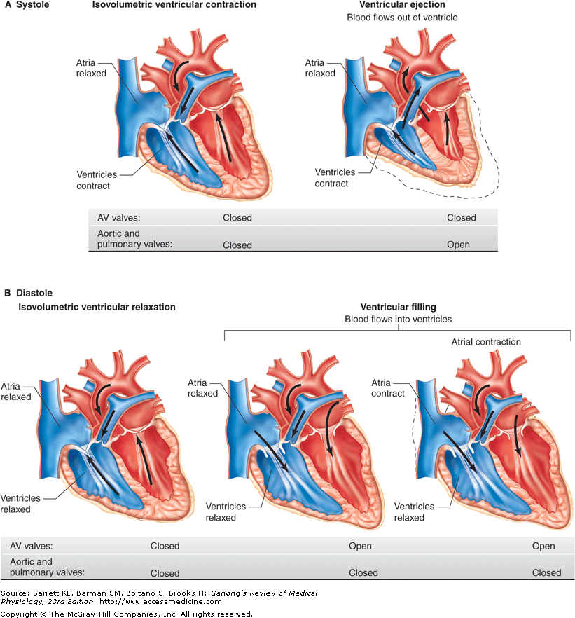
Blood flow and myocardial contraction
Late in systole, aortic pressure actually exceeds left ventricular pressure.
However, the momentum of the blood keeps it flowing out of the ventricle for a short period.
The pressure relationships in the right ventricle and pulmonary artery are similar.
Fig. 31-2 Accessed 02/01/2010

Slide 3
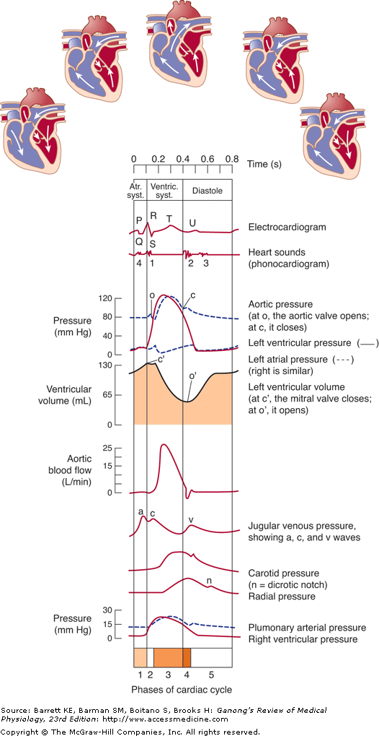
Cardiac cycle
Phases
Atrial systole
Isovolumetric ventricular contraction
Ventricular ejection
Isovolumetric ventricular relaxation
Ventricular filling.
Fig. 31-3 Accessed 02/01/2010

Slide 4
Blood flow and myocardial contraction
Phases
1. Atrial systole
2. Isovolumetric ventricular contraction
3. Ventricular ejection
Late in systole, aortic pressure actually exceeds left ventricular pressure.
However, the momentum of the blood keeps it flowing out of the ventricle for a short period.
4. Isovolumetric ventricular relaxation
5. Ventricular filling.
The pressure relationships in the right ventricle and pulmonary artery are similar.

Slide 5
Physiologic splitting
During expiration
The aortic and pulmonic components of the second heart sound are separated by <30 ms
Are appreciated as a single sound.
During inspiration
The splitting interval widens
The components are clearly separated into two distinct sounds.

Slide 6
Pathologic splitting
Narrow physiologic splitting
Occurs in pulmonary hypertension
Both components are heard during expiration
Because of the increased intensity and high- frequency composition of P₂.
Wide physiologic splitting is caused by a delay in pulmonic valve closure.
Complete right bundle branch block

Slide 7
Pathologic splitting
Reversed splitting
Delay in aortic valve closure
Usually due to impaired left ventricular emptying
With inspiration, the splitting interval narrows
Aortic stenosis, left bundle branch block, hypertrophic cardiomyopathy
Paradoxical splitting
Early pulmonic valve closure
Wolf-Parkinson-White syndrome

Slide 8
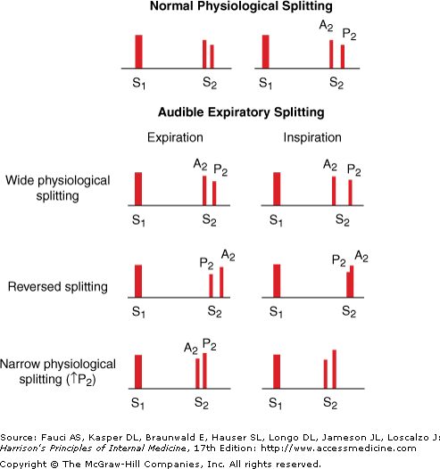
Splitting
(From JA Shaver, JJ Leonard, DF Leon, Examination of the Heart, Part IV, Auscultation of the Heart. Dallas, American Heart Association, 1990, p
17. Copyright, American Heart Association.)

Slide 9
Abnormal heart sounds
Fixed split of S₁
Right bundle branch block
Fixed split of S₂
Associated with atrial septal defect
S₃ pathognomonic for volume overload
S₄ pathognomonic for stiff ventricle
S₃ and S₄ originating from the right ventricle diminish with expiration and increase with inspiration
S₃ and S₄ originating from the left ventricle, increase
with expiration and decrease with inspiration

Slide 10
Turbulence
Blood flow is streamlined
Concentric layers of fluid slip past each other
The slowest layers are at the interface between blood and vessel wall
The fastest layers are in the center of the blood
vessel
When the critical velocity is reached, turbulent flow results.
Flow does not increase as much for a given rise in pressure because energy is lost in the turbulence.
•
•

Slide 11
Cardiac murmurs
Associated with an underlying cardiac abnormality
Holosystolic murmur(positive likelihood ratio, LR+, 8.7; LR-, 0.2)
Loud murmur (LR+, 6.5; LR-, 0.1)
Systolic thrill (LR+,12)
Decreased carotid upstroke
Diastolic murmurs always important.

Slide 12
Current Diagnosis & Treatment: Pediatrics, 25e

Slide 13
Systolic heart murmurs
Early systolic:
Large ventricular septal defects with pulmonary hypertension
Very small muscular ventricular septal defects.
Tricuspid regurgitation occurring in the absence of pulmonary hypertension
Common in narcotics abusers with infective endocarditis

Slide 14
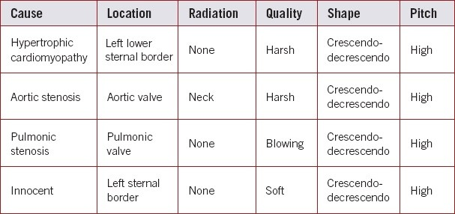
Mid-systolic murmurs
https://journals.lww.com/jaapa/fulltext/2019/12000/cardiac_auscultation using_physiologic_man euvers.4.aspx

Slide 15
Systolic heart murmurs
Mid-systolic (diamond shaped):
Aortic stenosis
Pulmonic stenosis
Late systolic:
Papillary muscle dysfunction
Holosystolic:
Mitral regurgitation
Tricuspid regurgitation
Ventricular septal defect.

Slide 16
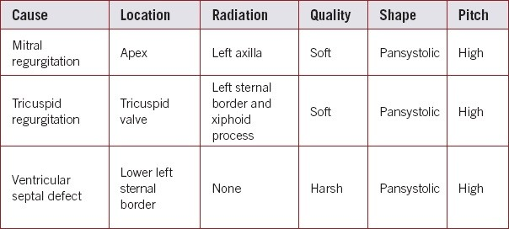
Holosystolic murmurs
https://journals.lww.com/jaapa/fulltext/2019/12000/cardiac_auscultation using_physiol ogic_maneuvers.4.aspx

Slide 17
Diastolic heart murmurs
Early (decrescendo):
Aortic regurgitation
Pulmonic regurgitation
Mid-diastolic:
Mitral stenosis
Tricuspid stenosis

Slide 18
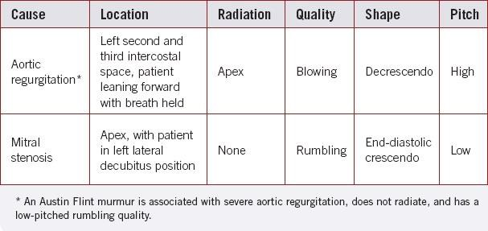
Diastolic murmurs
https://journals.lww.com/jaapa/fulltext/2019/12000/car diac_auscultation using_physiologic_maneuvers.4. aspx

Slide 19
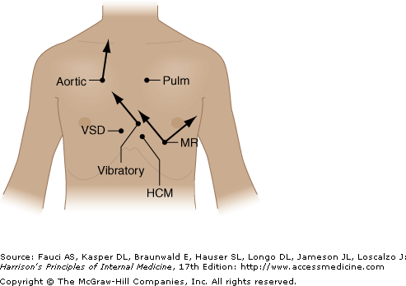
Maximal intensity and radiation of six isolated systolic murmurs

Slide 20
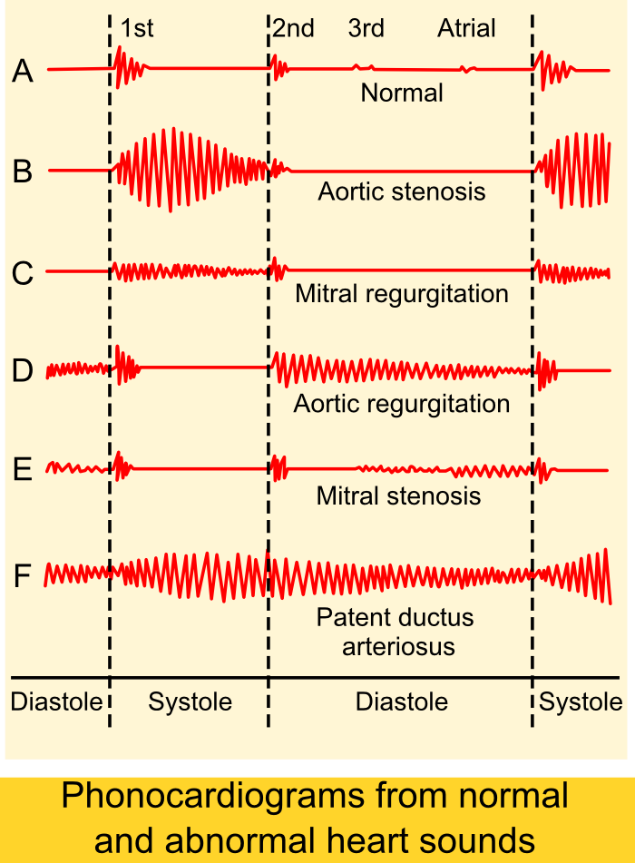
https://en.wikipedia. org/wiki/Heart_murm ur#/media/File:Phon ocardiograms_from_ normal_and_abnorm al_heart_sounds.pn g

Slide 21
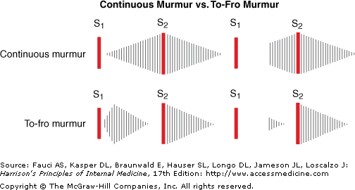
Heart murmurs
(From JA Shaver, JJ Leonard, DF Leon, Examination of the Heart, Part IV, Auscultation of the Heart. Dallas, American Heart Association, 1990, p 55. Copyright, American Heart Association.)

Slide 22
Continuous murmur
Abnormal communication between high-pressure and low-pressure systems
Large pressure gradient exists throughout the cardiac cycle, producing a continuous murmur.
A classic example is patent ductus arteriosus.
A continuous murmur crescendos to around
S₂, and decrescendos to S₁.
Another example is a large ventricular septal defect.
Holosystolic or pansystolic murmur

Slide 23
To-fro murmur
Combination of systolic ejection murmur and a murmur of semilunar valve incompetence.
A to-fro murmur has two components.
The mid-systolic ejection component decrescendos and disappears as it approaches S₂.
Aortic stenosis and regurgitation.

Slide 24
Change in position affects dynamics
Standing decreases preload
Murmur decreases in intensity
Squatting increases venous return to the right side of the heart with compression of the veins in the lower extremities.
There is increased right-sided preload; thus increased left-sided preload

Slide 25
Change in position affects dynamics
With a Valsalva maneuver, there is increased intrathoracic pressure.
This also causes increased vascular resistance in the left side of the heart and the pulmonary venous system.
This reduces intraluminal pressure in the pulmonary
vessels and reduces left ventricular filling
Decreased right-sided preload causes decreased left- sided preload

Slide 26
Change in position affects dynamics
With the exception of mitral vale prolapse and hereditary hypertrophic cardiomyopathy, all other murmurs decrease with Valsalva.
Passive leg raising increases preload
Murmur increases in intensity but not in hereditary
hypertrophic cardiomyopathy

Slide 27
Change in position affects dynamics
Standing from a squatting position decreases preload and is associated with an initial increase in intensity of murmur if mitral regurgitation, but not mitral valve prolapse
Squatting from a standing position increases preload
AND increases afterload

Slide 28
Change in position affects dynamics
Hand grip maneuver increases afterload
The murmurs of aortic regurgitation, mitral regurgitation, and VSD increase in intensity
The intensity of the diastolic murmur in mitral
regurgitation increases
May also accentuate gallops
The murmurs of aortic stenosis, hereditary hypertrophic cardiomyopathy, and mitral valve prolapse decrease in intensity.

Slide 29
Change in position affects dynamics
Inspiration increases right-sided heart murmurs (tricuspid and pulmonary valves) and expiration increases left-sided murmurs (mitral and aortic valves)
Valsalva maneuver accentuates right sided murmurs
Increased inspiration but not Valsalva accentuates S₂
splitting and a right sided S₃ (gallop).
This is Carvallo’s sign.
•

Slide 30
Mid-systolic murmurs
If the cause is hypertrophic cardiomyopathy, standing and Valsalva maneuvers increase the murmur; squatting and handgrip maneuvers decrease it.
If the cause is aortic stenosis, squatting and leg raises increase the murmur; standing, Valsalva, and handgrip maneuvers decrease it.
If the cause is pulmonic stenosis, inspiration increases the murmur.
20% of children with an “innocent” murmur (diminishes upon standing) have congenital heart disease.

Slide 31
Holosystolic murmurs
If the cause is mitral regurgitation, squatting and handgrip maneuvers increase the murmur; standing and Valsalva maneuvers decrease it.
If the cause is tricuspid regurgitation, inspiration increases the murmur.
If the cause is a ventricular septal defect, squatting and handgrip maneuvers increase the murmur; standing decreases it.

Slide 32
Diastolic murmurs
If the cause is aortic regurgitation, squatting, leg raise, and handgrip maneuvers increase the murmur; standing and Valsalva maneuvers decrease it.
If the cause is mitral stenosis, the murmur increases with the handgrip maneuver, or when the patient is placed in the left lateral decubitus position with his or her breath held in exhalation

Slide 33
Acute coronary syndrome murmurs
Ventricular septal rupture may develop after an anteroseptal infarction.
The patient will exhibit respiratory distress and acute heart failure.
Auscultation will reveal a loud, harsh, holosystolic murmur with a palpable thrill.
Left ventricular dilation secondary to ischemia or heart failure can cause mitral regurgitation and a holosystolic, high-pitched murmur.
An isometric handgrip or leg raising will increase the murmur's intensity.

Slide 34
Acute coronary syndrome murmurs
Chordae tendinae rupture, papillary muscle rupture, and papillary muscle dysfunction are complications of acute coronary syndrome and can cause acute mitral regurgitation and a new holosystolic harsh murmur.
Another complication after ACS is a reactive pericarditis (Dressler syndrome) that can cause a pericardial friction rub.

Slide 35
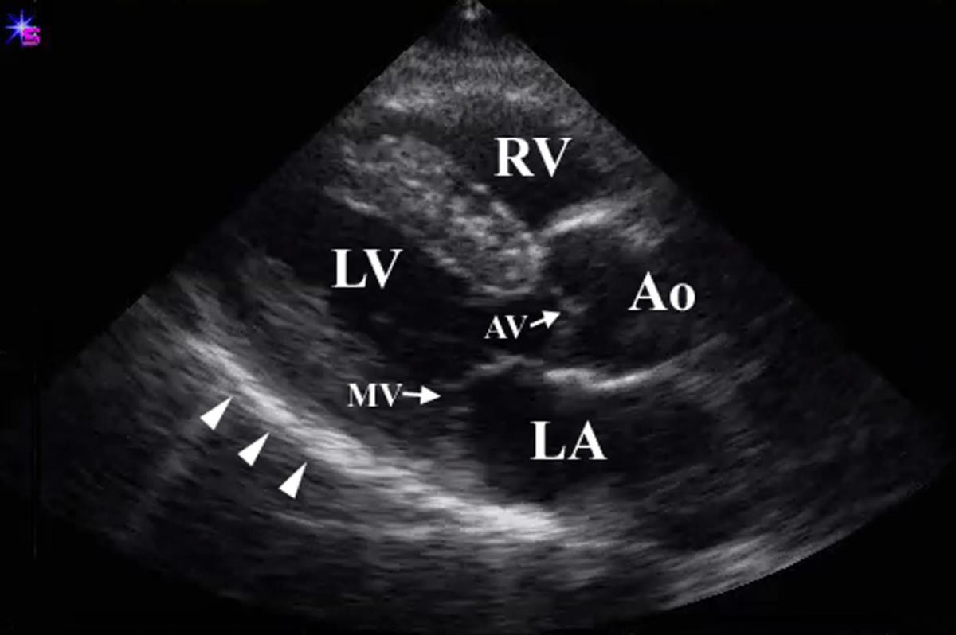
Cardiac Ultrasound Parasternal view long axis
www.acep.org/sonoguide/cardiac.html
Accessed 09/10/2019

Slide 36
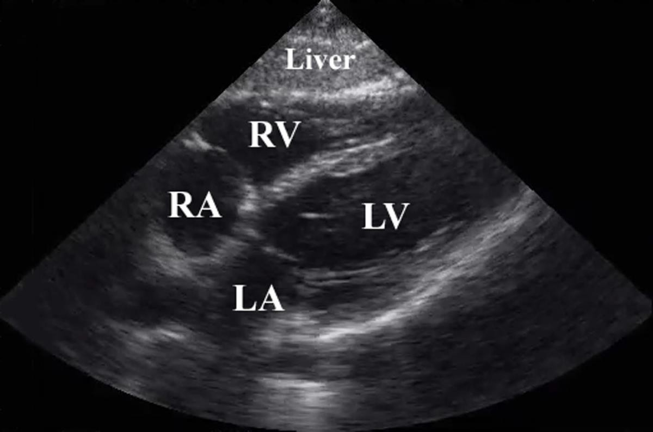
Cardiac Ultrasound Subxiphoid view
www.acep.org/sonoguide/cardiac.html
Accessed 09/10/2019

Slide 37
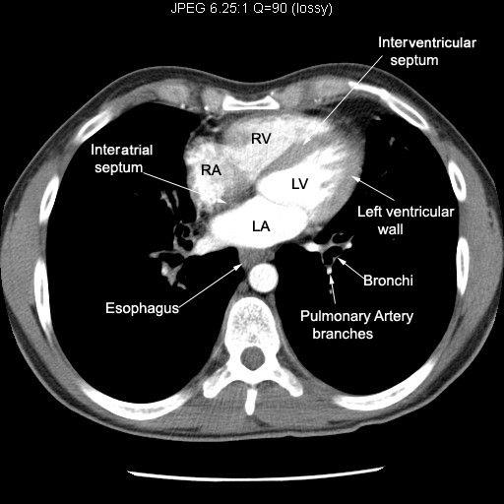
https://duckduckgo.com/?q=mitral+valve+regurgitation+photos&t=ffab&iax=images&ia=images&iai=https%3A
%2F%2Fs-media-cache- ak0.pinimg.com%2F736x%2Fdf%2F25%2F9c%2Fdf259cf6f39b43123f536abbce490382--mitral-valve- regurgitation-septum.jpg Accessed 12/07/2019
MIRROR IMAGE

Slide 38
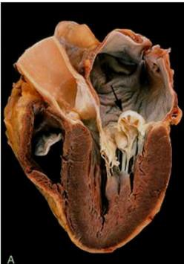
Valve distribution
The arrow points to a ballooned mitral valve. The other valves are structurally normal.
Schoen, and FJ, Mitchell, RN, “Heart”, in Kumar, V, Abbas, AK, Aster, JC (eds.), Robbins and Cotran Pathologic Basis of Disease, 9th edition. 2015. Elsevier. Philadelphia. Fig. 12- 22.

Slide 39
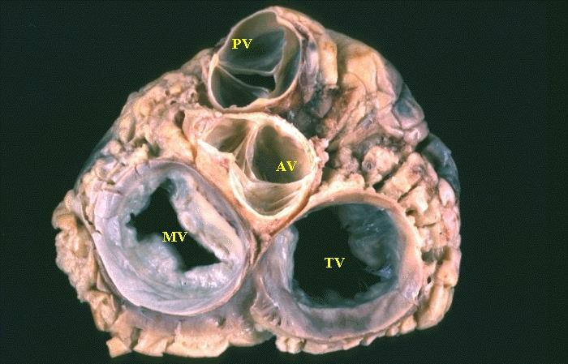
Native heart valves
med.uottowa.ca
Accessed 09/10/2019

Slide 40
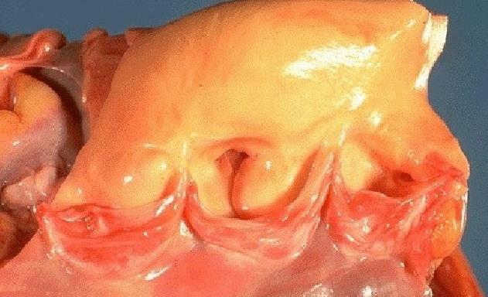
Native Aortic Valve
Klatt, EC, Robbins and Cotran Color Atlas of Pathology. (2015) Elsevier. Philadelphia. Fig. 2-7 Accessed 09/01/2019

Slide 41
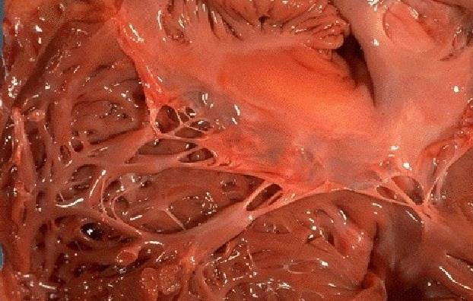
Native Tricuspid valve
Klatt, EC, Robbins and Cotran Color Atlas of Pathology. (2015) Elsevier. Philadelphia. Fig. 2-8 Accessed 09/01/2019

Slide 42
Valvular disease
The valves are subject to repetetive injury
Open/close
High trans valvar pressures at opening/closing
This leads to transient deformation of the valve
Diseases of the valves cause either stenosis
Blockage of blood flow through the valve
OR regurgitation
Leakage of blood back through the valve
A misshapen valve that does not open all the way is not likely to close completely.
In “combined” stenosis and regurgitation, one hemodynamic abnormality typically predominates.

Slide 43
Valvular disease
Stenosis develops chronically
Regurgitation can develop acutely or chronically
Chronic conditions affecting the valves allow for compensatory changes
Acute conditions do not allow for compensatory change.
Functional regurgitation stems from abnormality to supporting structure
An abnormally formed valve leads to pressure overload of the involved atrium or ventricle.
An incompetent valve leads to volume overload
•

Slide 44
Obstruction to left ventricular outflow
Produces systolic pressure gradient between the left ventricle and the aorta.
The left ventricle responds by dilatation and reduction of stroke volume.
Left ventricular output is maintained by the presence of concentric left ventricle hypertrophy.
When hypertrophy becomes maladaptive, left ventricle function declines.
Hypertrophy elevates myocardial oxygen requirements.
Coronary artery perfusion decreases as increased muscular pressure compresses coronary arteries.
•
•

Slide 45
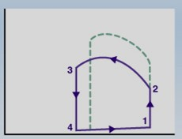
Increase in afterload
Left ventricular pressure
Normal
Increased afterload
Increased systolic pressure (1-2)
Decreased stroke volume (mid-width of PV loop)
Increased end systolic volume (baseline)
A
B
Left ventricular volume

Slide 46
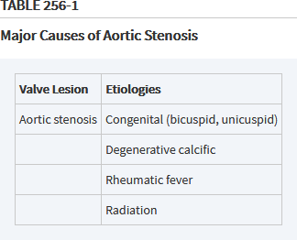

Slide 47
Aortic stenosis
In aortic stenosis left ventricular emptying is impaired because of high outflow resistance caused by a reduction in the valve orifice area when it opens.
This high outflow resistance causes a large pressure gradient to occur across the aortic valve during ejection, such that the peak systolic pressure within the ventricle is greatly increased.
This leads to an increase in ventricular wall stress (afterload), a decrease in stroke volume, and an increase in end-systolic volume.

Slide 48
Aortic stenosis
Stroke volume decreases because the velocity of fiber shortening is decreased by the increased afterload
Because end-systolic volume is elevated, the excess residual volume added to the incoming venous return causes the end-diastolic volume to increase.
Stroke volume falls because the end-systolic volume increases substantially more than the end-diastolic volume increases.
The fall in stroke volume can lead to a reduction in arterial pressure.
Stroke volume falls even further if the ventricle begins to exhibit systolic and diastolic dysfunction.

Slide 49
Aortic stenosis
Compensatory increases in end-diastolic volume will be limited by ventricular hypertrophy that occurs due to the chronic increase in afterload.
This hypertrophy can lead to a large increase in end-diastolic pressure that is associated with reduced end-diastolic volumes because the increased stiffness of the ventricle prevents normal ventricular filling.

Slide 50
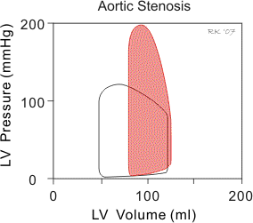
Aortic stenosis (red)
https://www.cvphysiology.com/Heart%20Disease/HD009b

Slide 51
Aortic stenosis
In developed countries, the etiology of aortic stenosis (AS) is a process akin to but is not atherosclerosis
The initial lesion is plaque-like with a central core of lipids and macrophages.
Over time the plaque becomes calcified and in 15% of cases actually contains lamellar bone.
The process holds in common many of the risk factors for atherosclerotic coronary disease, including hyperlipidemia, hypertension, and the metabolic syndrome.
Lp(a), not LDL, associated with progression

Slide 52
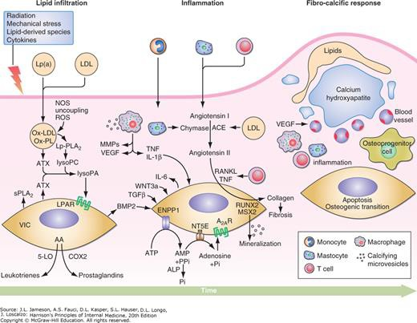

Slide 53
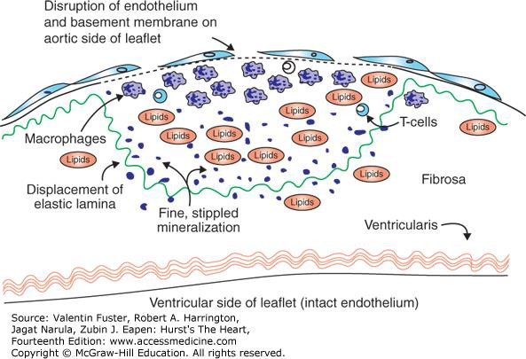
The early plaque of aortic stenosis demonstrating similarities to an atherosclerotic plaque. Reproduced with permission from Otto CM, Kuusisto J, Reichenbach DD, et al: Characterization of the early lesion of ‘degenerative’ valvular aortic stenosis. Histological and immunohistochemical studies. Circulation. 1994 Aug;90(2):844-853.
Citation: AORTIC VALVE DISEASE, Fuster V, Harrington RA, Narula J, Eapen ZJ. Hurst's The Heart, 14e; 2017. Available at: https://accessmedicine.mhmedical.com/content.aspx?bookid=2046&sectionid=176557433 Accessed: April 22, 2020 Copyright © 2020 McGraw-Hill Education. All rights reserved

Slide 54
Aortic valve stenosis
Congenitally bicuspid valve.
1-2% of population
One-third become stenotic
50% of those under 70 years of age.
Prevalent in Turner’s syndrome
Nodules of calcium are on the sinus side of the cusps.
In most cases, bicuspid valves have one smaller cusp and one large cusp.
The larger cusp may have a midline raphe, representing incomplete separation of two cusps
Major site of calcification
•
•

Slide 55
Aortic valve stenosis
Ejection sound characteristic.
Loss of function Notch 1 mutation at 9q34.3 in familial cases
NKX2.5 (endothelial nitric oxide synthase) implicated
Medial degeneration with aneurysm formation frequent
LV responds by dilation and reduction of stroke volume (concentric hypertrophy)
Echocardiogram diagnostic

Slide 56
Aortic valve stenosis
Calcified aortic valve
Degenerative change
Most common cause in patients over 70 years of age.
Calcification of the sinus side of the cusps with little involvement of the commissures
Extends into sinus of Valsalva Metaplastic bone formation identified
May also see calcification of mitral annulus (clinically unimportant)
Also consequence of rheumatoid arthritis valvulitis
•
•
•

Slide 57
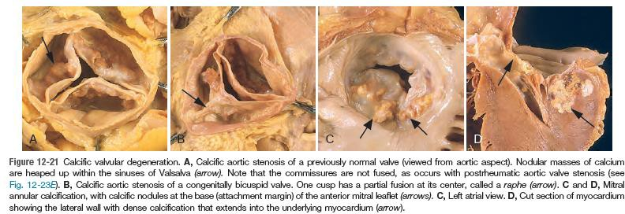

Slide 58
Aortic valve stenosis
Angina, syncope, and congestive heart failure are the cardinal symptoms of aortic valve stenosis
Post inflammatory rheumatic heart disease has been the principal cause in the pre-antibiotic era.
The commissures separating the cusps may be fused.
Symptoms appear when valve area <1cm² Normal valve area 3cm²
Both aortic and mitral regurgitation may be present.
•
•
•

Slide 59
Consequences of aortic valve stenosis
Concentric hypertrophy
Ventricular adaptation to resistance to flow through the valve
Diminished compliance
Chest pain
Poor filling of coronary arteries
Increased O₂ demands of ventricular myocardium.
Syncope
Impaired cerebral perfusion

Slide 60
Aortic valve stenosis
Attenuated carotid pulse with a delayed carotid upstroke
(pulsus parvus et tardus).
Paradoxically split S₂
Pulmonic valve closes before the aortic valve.
High-pitched systolic ejection-type systolic murmur (crescendo-decrescendo) at right upper sternal border.
Radiates to carotid.
Ejection click after S₁ as well if bicuspid valve.
The murmur diminishes in intensity
Abrupt standing from the supine position
Valsalva maneuver
Sustained hand grip.

Slide 61
Aortic stenosis
Moderate to severe aortic stenosis
>40% regurgitant fraction
Slow carotid upstroke (LR+ 9.2)
Diminished S₂ (LR+ 7.5),
Reduced carotid pulse volume (LR+ 2.0)
Gallavardin’s phenomenon
Late systolic murmur that is loud over the aortic area, diminishes over the sternum, reappears at apex
May confuse with mitral regurgitation
Absence of radiation to right clavicle makes moderate to severe aortic stenosis unlikely (LR- 0.10).

Slide 62
Aortic stenosis
Current AHA/ACC guidelines subdivide the severe, symptomatic AS group of patients into three separate categories (based on echocardiography):
High-gradient AS (D1)
Low-flow/low-gradient AS with reduced EF (D2)
Low-gradient AS with normal EF
35-51% of patients have arterial hypertension
Increase in Brain natriuretic peptide (BNP) during exercise is a poor prognostic sign
Acquired vonWillebrand’s disease associated with bleeding
Valve replacement is the only therapy

Slide 63
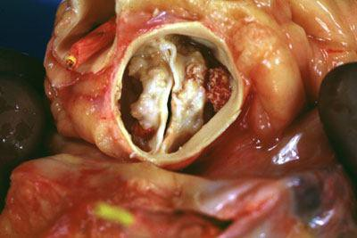
Bicuspid Aortic Valve
www.slideshare.net/jyotindrasingh82/bicuspid-aortic-valve. Accessed 09/10/2019.

Slide 64
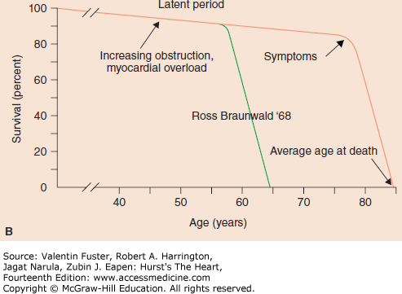
A. The natural history of aortic stenosis demonstrating a dramatic decline in survival when symptoms develop. B. The natural history of aortic stenosis today (pink line) showing onset of symptoms at a much later age in life than in the 20th century (green line). A reproduced with permission from Ross J Jr, Braunwald E: Aortic stenosis, Circulation. 1968 Jul;38(1 Suppl):61-67. B used with permission from Dr. Robert Bonow.
Citation: AORTIC VALVE DISEASE, Fuster V, Harrington RA, Narula J, Eapen ZJ. Hurst's The Heart, 14e; 2017. Available at: https://accessmedicine.mhmedical.com/content.aspx?bookid=2046&sectionid=176557433 Accessed: April 22, 2020 Copyright © 2020 McGraw-Hill Education. All rights reserved

Slide 65
Prognosis of aortic valve stenosis
Death generally follows in:
5 years following presentation of angina
3 years following presentation of syncope
2 years following presentation of congestive heart failure.
Replace valve shortly after symptom presentation.

Slide 66
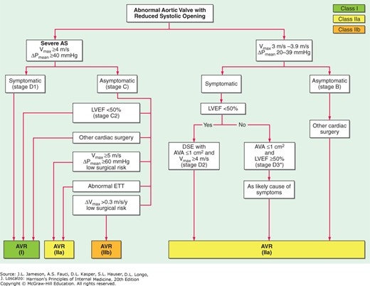

Slide 67
Hereditary hypertrophic cardiomyopathy
Young adults
30-40% of cardiomyopathies in children
Autosomal dominant (variable penetrance)
Defective energy transfer from mitochondrion to sarcomere
Apical hypertrophy reduces ventricular volume
10% have concentric hypertrophy (restricted filling)
Left ventricular septum three times thicker than free wall (asymmetric hypertrophy)
Prominent in sub aortic region (25%)
Dynamic dysfunction

Slide 68
Hereditary hypertrophic cardiomyopathy
Asymmetrical septal hypertrophy without obstruction
Asymmetrical septal hypertrophy with obstruction (hypertrophic obstructive cardiomyopathy)
Mitral regurgitation from septum striking valve

Slide 69
Hereditary hypertrophic cardiomyopathy
Maximal intensity of murmur
5th left intercostal space
Radiates along the left lower sternal border.
Passive leg elevation decreases the intensity of the murmur (LR+ 8.0; LR- 0.2).
Squatting decreases intensity of murmur (LR+ 4.5; LR- 0.1).
Histopathology:
Giant myocytes
Myofiber disarray
Fibrosis

Slide 70
Hereditary hypertrophic cardiomyopathy
Complications include:
Atrial fibrillation
Thrombus formation (and embolism)
Ventricular fibrillation (sudden death)
Treatment
β-blocker
Reduce heart rate (increase preload)
Decrease myocardial contractility
Implantable cardioverter defibrillator
May have to excise myocardial tissue in outflow tract

Slide 71
Supravalvular aortic stenosis
Autosomal dominant.
7q11.23 mutation affects elastin.
Characterized by narrowing of the ascending aorta above the level of the sinus of Valsalva.
Williams-Beuren syndrome characterized additionally by transient hypercalcemia, elfin facial appearance with low bridge nose, and stenosis of other major arteries.
Developmental delay with good language skills; impaired spatial processing.
•
•

Slide 72
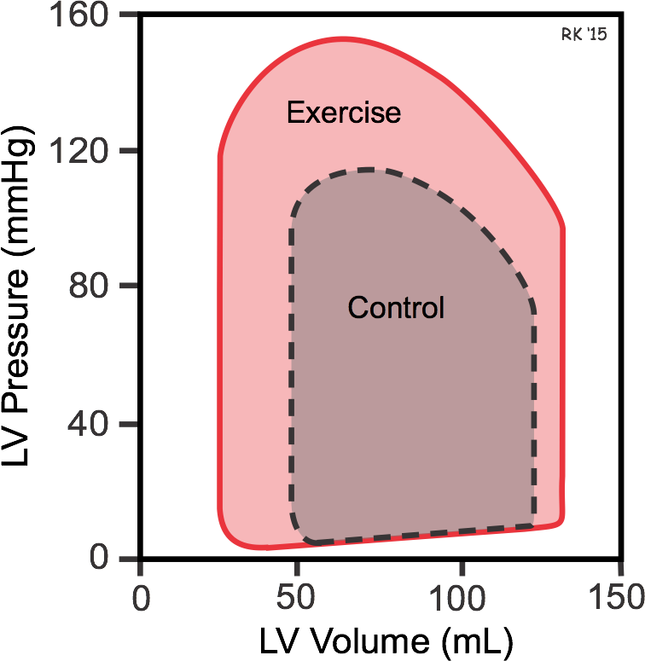
P-V LOOP IN SEVERE EXERCISE

Slide 73
Coarctation of the aorta
One-third of patients with Turner’s syndrome have Coarctation.
Bicuspid aortic valve
25% of all coarctations
Ejection click at right upper sternal border.
Blood pressure in upper limbs is greater than blood pressure in lower limbs.
Associated with saccular cerebral aneurysms.

Slide 74
Coarctation of the aorta
Preductal if before ligamentum arteriosum.
Usually discovered in infancy.
Presents with congestive heart failure
May see right bundle branch block
If patent ductus arteriosum is present, may see cyanosis of lower half of body.

Slide 75
Coarctation of the aorta
Postductal if after ligamentum arteriosum.
Presents as systemic hypertension
Blood pressure in upper limbs is greater than blood pressure in lower limbs.
S_{a}O₂ difference > 5% between upper limb and lower limb.
Left ventricular hypertrophy on EKG May see rib notching on chest x-ray
Caused by dilated collateral vessels.
•
•
•

Slide 76
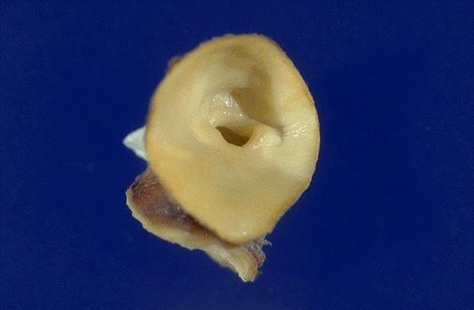
Coarctation of the aorta
Post-ductal Coarctation. Note post-ductal narrowing of the aorta.
https://webpath.med.utah.edu/CVHT ML/CV081.html
Accessed 12/10/2019

Slide 77
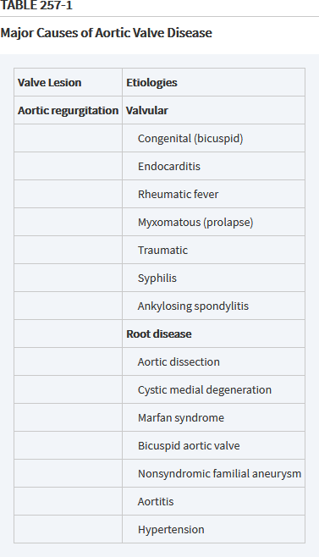

Slide 78
Aortic valve regurgitation
Men 3:1
Women, if previous history of rheumatic heart disease
Presents when decreased cardiac output develops.
Dyspnea
Orthopnea
Paroxysmal nocturnal dyspnea
Fatigue and weakness
Anginal pain

Slide 79
Aortic valve regurgitation
Blood pressure in the leg is more than 20 mm Hg higher than pressure in the arm (Hill sign).
Bounding pulse (Corrigan or water-hammer pulse) due to increased pulse pressure (difference between systolic and diastolic).
Bisferious pulse (with two systolic peaks).
Alternate flushing and paling of the skin at the root of the nail while pressure is applied to the tip of the nail (Quincke’s pulse)

Slide 80
Aortic valve regurgitation
Severe aortic valve regurgitation
>40% regurgitant fraction
S₃ presence (LR+ of 5.9)
Absence of S₃ does not exclude.
Doppler echocardiography needed.

Slide 81
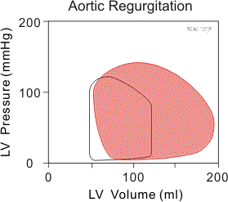
Aortic stenosis (red)
https://www.cvphysiology.com/Heart%20Disease/HD009d

Slide 82
Aortic regurgitation
In aortic valve regurgitation the aortic valve does not close completely at the end of systolic ejection.
Therefore, there is no true phase of isovolumetric relaxation because as the ventricle relaxes, even before the mitral valve opens, blood is entering the ventricle from the aorta thereby increasing ventricular volume.
Once the mitral valve opens, filling occurs from the left atrium

Slide 83
Aortic regurgitation
Blood continues to flow from the aorta into the ventricle throughout diastole because aortic pressure is higher than ventricular pressure during diastole.
This greatly enhances ventricular filling so that end- diastolic volume is increased.
Ventricular end-diastolic volume is also increased because in chronic aortic regurgitation the ventricle anatomically dilates (remodels) so that ventricular compliance is elevated.
This is the major hemodynamic compensation

Slide 84
Aortic regurgitation
There is no true isovolumetric contraction as the ventricle begins to contract and develop pressure, blood is still entering the ventricle from the aorta because aortic pressure is higher than ventricular pressure
Volume continues to increase
LV dilation increases the LV systolic tension required to develop any given level of systolic pressure (Laplace’s Law)
The dilation and eccentric hypertrophy of the LV allow this chamber to eject a larger stroke volume without requiring any increase in the relative shortening of each myofibril.

Slide 85
Aortic regurgitation
The increased end-diastolic volume (increased preload) leads to an increase the force of contraction, ventricular peak (systolic) pressure, and stroke volume.
Once the ventricular pressure exceeds the aortic diastolic pressure, the ventricle then begins to eject blood into the aorta.

Slide 86
Aortic regurgitation
As long as the ventricle is not in failure, end- systolic volume may only be increased a small amount due to the increased afterload (ventricular wall stress).
If the ventricle goes into systolic failure, then end- systolic volume will increase by a large amount and the peak systolic pressure and stroke volume (net forward flow into aorta) will fall.

Slide 87
Acute aortic regurgitation
Infective endocarditis with perforation of the valve leaflet most common cause
Dissecting aneurysm of the ascending aorta dilates the aortic ring
There is a significant decrease in the intensity of the systolic ejection murmur
Because of the decreased forward stroke volume.
S₁ is markedly decreased in intensity
Because of premature closure of the mitral valve.
•

Slide 88
Acute aortic regurgitation
The presystolic component of the Austin-Flint (diastolic) murmur is absent at the apex.
The early diastolic murmur at the base ends before S₁
Because of equilibration of the left ventricle and aortic end-diastolic pressure.
Significant tachycardia is usually present.
•

Slide 89
Chronic aortic regurgitation
Dilatation of the aortic ring
60% of cases
Syphilitic aneurysm of the ascending aorta
Marfan’s syndrome
Ankylosing spondylitis
Takayasu’s arteritis

Slide 90
Chronic aortic regurgitation
40% of cases are of valvular origin
Rheumatic heart disease most common cause of aortic valve regurgitation.
Often mitral regurgitation is present as well.
Bicuspid aortic valves as another cause.

Slide 91
Chronic aortic regurgitation
A prominent systolic ejection murmur
Heard at the base and the apex
Ends before S₂
Results from a large forward stroke volume
Diastolic murmur
Begins with S₂ and continues in a decrescendo fashion, terminating before S₁.
Best heard at left upper sternal border with the patient sitting up and leaning forward.
Squatting increases the intensity of the murmur.

Slide 92
Chronic aortic regurgitation
Austin-Flint murmur (diastolic rumble)
Best heard at the apex
Arises from regurgitant jet striking anterior mitral leaflet.
The mid-diastolic component of Austin Flint murmur is introduced by a prominent S₃.
A pre-systolic component of the Austin Flint murmur is also heard.

Slide 93
Chronic aortic regurgitation
May result in functional mitral regurgitation.
Cardiac output decreases.
Coronary perfusion pressure also decreases.
Surgical intervention if severe disease.
Vasodilator may improve hemodynamics prior to surgery.

Slide 94
Testing
In chronic severe aortic regurgiation, the apex is displaced downward and to the left in the frontal projection.
In the left anterior oblique and lateral projections, the left ventricle is displaced posteriorly and encroaches on the spine.
When aortic regurgitation is caused by primary disease of the aortic root, aneurysmal dilation of the aorta may be noted, and the aorta may fill the retrosternal space in the lateral view.
Echocardiograpy diagnostic

Slide 95
Treatment
Valve replacement early as patients symptomatic only after LV dysfunction develops
Valve sparing aortic root reconstruction if due to annular dilatation

Slide 96
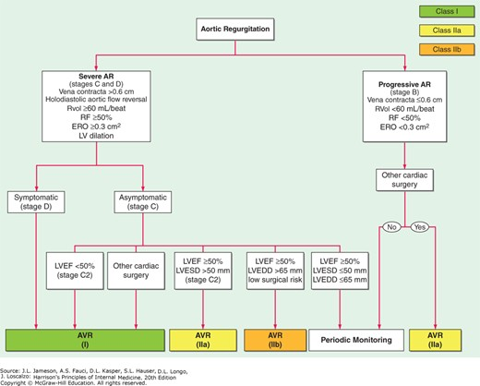

Slide 97
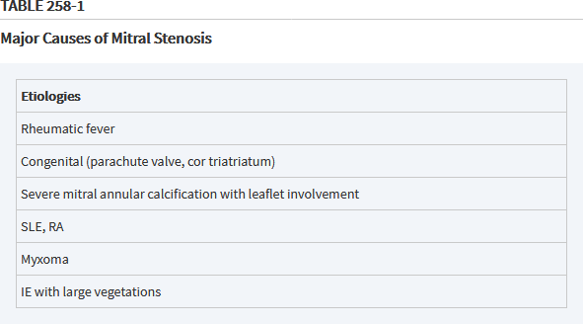

Slide 98
Mitral stenosis
The mitral valve is the most common valve affected in rheumatic fever.
Stenosis is caused by fusion, thickening, and shortening of the chordae tendinae and valve leaflets.
Left atrial dilatation
Most patients are asymptomatic
Atrial fibrillation in 40% of patients
Development of mural thrombi in 30%
60-75% of emboli to brain
Passive pulmonary congestion with hemoptysis
Left atrial and pulmonary arterial wedge pressures are elevated (pulmonary hypertension).

Slide 99
Mitral stenosis
Mitral stenosis impairs left ventricular filling
There is a decrease in end-diastolic volume (preload)
This leads to a decrease in stroke volume and a fall in cardiac output.
Reduced ventricular filling and reduced aortic pressure decrease ventricular wall stress (afterload)
Results in a small decrease in ventricular end- systolic volume that is not sufficient to offset the reduction in end-diastolic volume.

Slide 100
Mitral stenosis
Is more the consequence of abnormal loading and LV remodeling than of myocardial dysfunction.
Right ventricular failure also seems to be a consequence of increased afterload rather than of myocardial dysfunction.

Slide 101
Mild mitral stenosis
Diastolic gradient across the valve is limited to the two phases of rapid ventricular filling in early diastole and pre-systole.
Low-pitched diastolic rumbling heard best at the apex with the patient in the left lateral decubitus position.
The rumble may occur during either or both periods.
Mitral stenosis often produces an early opening snap from fused leaflet tips.
•

Slide 102
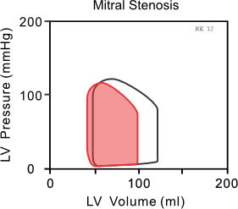
Mitral stenosis (red)
https://www.cvphysiology.com/Heart%20Disease/HD009a

Slide 103
Severe mitral valve stenosis
A large pressure gradient exists across the valve during the entire diastolic filling period
Rumble persists throughout diastole.
As the left atrial pressure becomes greater
The interval between the aortic valve component and the opening snap shortens.

Slide 104
Severe mitral valve stenosis
As secondary pulmonary hypertension develops
Loud pulmonic valve component
Splitting interval usually narrows.
With sustained hand grip, the diastolic murmur is accentuated.

Slide 105
Clinical and hemodynamic features
Influenced importantly by the level of the pulmonary artery pressure
Pulmonary hypertension results from:
(1) passive backward transmission of the elevated LA pressure;
(2) pulmonary arteriolar constriction (the so-called “second stenosis”),
Triggered by LA and pulmonary venous hypertension (reactive pulmonary hypertension);

Slide 106
Clinical and hemodynamic features
(3) interstitial edema in the walls and pulmonary venous hypertension
Reactive pulmonary hypertension
At end stage, obliterative changes in the pulmonary vascular bed are identified

Slide 107
Testing
The earliest changes are straightening of the upper left border of the cardiac silhouette, prominence of the main pulmonary arteries, dilation of the upper lobe pulmonary veins, and posterior displacement of the esophagus by an enlarged left atrium.
Kerley B lines are fine, dense, opaque, horizontal lines that are most prominent in the lower and mid- lung fields that result from distention of interlobular septae and lymphatics with edema when the resting mean left atrial pressure >20 mmHg.
Echocardiography is diagnostic

Slide 108
Treatment
Atrial fibrillation rate control with a β-blocker (esmolol) or calcium channel blocker (diltiazem)
Ivabradine improves exercise tolerance in heart failure
Vitamin K antagonist and low dose aspirin anticoagulation
Antibiotic prophylaxis not required
May require valvotomy or valve replacement.

Slide 109
Rheumatic heart disease
Acute, immunologically related multisystem inflammatory disease
Group A β-hemolytic Strep. (GAS) infection precipitates disorder
3% of patients
5-15 years of age usual
The streptococcal M protein shares an α-helical coiled structure with cardiomyocyte contractile proteins such as myosin (Type II hypersensitivity)
•

Slide 110
Rheumatic heart disease
The antibodies that contribute to rheumatic valvulitis target the N-acetyl-β-D-glucosamine–dominant epitope of the GAS carbohydrate, but also recognize sequences in α-helical proteins such as myosin and tropomyosin
Cross-reactive M-protein antibodies recognize the intracellular biomarker antigen cardiac myosin but target the valve surface endothelial antigen laminin

Slide 111
Rheumatic heart disease
The initial antibody-mediated damage to the endocardium leads to expression of vascular cell adhesion protein 1 on the valvular surface
Facilitates the infiltration of T cells into the valve substance, resulting in scarring and neovascularization. (Type IV hypersensitivity)
The biomarker antigen in the brain is tubulin and the antigen target on the cell surface leads to calcium/calmodulin-dependent kinase II activation and dopamine release (Sydenham chorea).

Slide 112
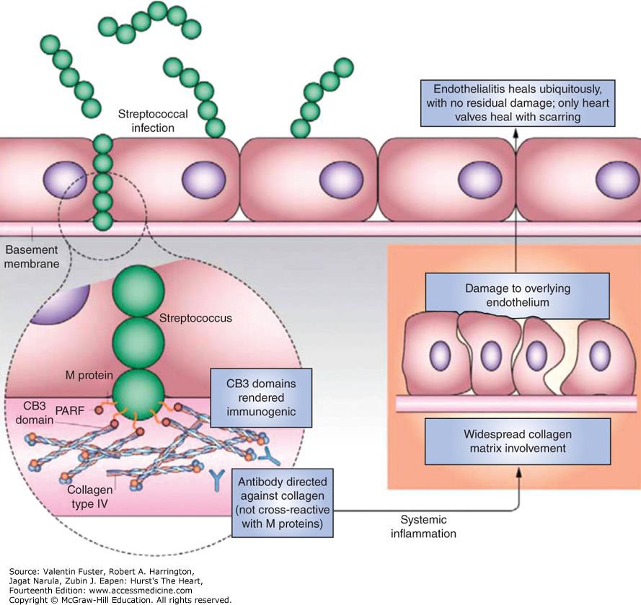
Proposed pathogenesis of rheumatic fever. Reproduced with permission from Tandon R, Sharma M, Chandrashekhar Y, et al: Revisiting the pathogenesis of rheumatic fever and carditis. Nat Rev Cardiol. 2013 Mar;10(3):171-177.¹⁹
Citation: ACUTE RHEUMATIC FEVER, Fuster V, Harrington RA, Narula J, Eapen ZJ. Hurst's The Heart, 14e; 2017. Available at: https://accessmedicine.mhmedical.com/content.aspx?bookid=2046&sectionid=176557361 Accessed: April 22, 2020
Copyright © 2020 McGraw-Hill Education. All rights reserved

Slide 113
Rheumatic heart disease
Streptococcal M proteins form a complex with collagen type IV in subendothelial basement membranes
Initiate an autoantibody response to the collagen as in Goodpasture’s or Alport’s syndromes
The M-like fibrinogen binding protein of Group G Streptococcus also complexes with subendothelial IV and is associated with a clinical picture of acute rheumatic fever

Slide 114
Acute rheumatic fever
ESSENTIALS OF DIAGNOSIS
Preceding group A streptococcal infection.
Initial acute rheumatic fever
Two major manifestations or one major plus two minor manifestations.
Recurrent acute rheumatic fever
two major or one major and two minor or three minor manifestations.

Slide 115
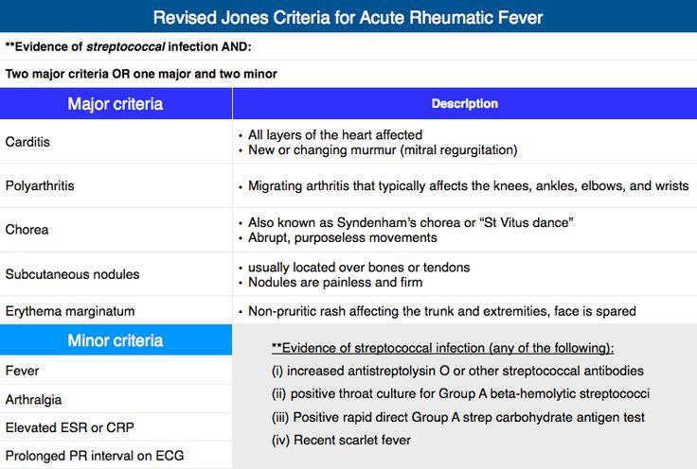
https://i.pinimg.com/736x/9f/03/70/9f0370ac3b6d69304e2550ba63a8440d--cardiology-pa-school.jpg Accessed12/07/2019

Slide 116
Complications
Carditis is the most serious consequence of rheumatic fever
50% of patients
More common in children
AV conduction delay
1% die
Pancardiac inflammation
But it may be limited to valves, myocardium, or pericardium.
Principally valvulitis
Usually mitral insufficiency

Slide 117
Complications
Myocarditis may lead to ventricular dilatation
Pericardial friction rub (serous effusion)
Carey-Combs murmur is a mid-diastolic rumble that improves as the valvulitis improves (flow across thickened mitral valve).
Best heard at the apex.
Subcutaneous nodules
Firm, painless, over joints
Common in patients with carditis

Slide 118
Complications
Mitral stenosis after acute rheumatic fever is rarely encountered until 5–10 years after the first episode.
The aortic valve is the second most common valve affected
Aortic insufficiency is occasionally encountered as the sole valvular manifestation of rheumatic carditis.
More common in men
More common in those of sub-Saharan origin

Slide 119
Complications
Migratory polyarthritis
More common in adults
80% of patients
Knees, hips, wrists, elbows, and shoulders most commonly involved
Monoarticular arthritis common in children and adolescents
No permanent damage

Slide 120
Complications
Erythema marginatum
A macular, serpiginous, erythematous rash with a sharply demarcated border appears primarily on the trunk and the extremities.
The face is usually spared.
Brought out by warm bath
4-15% of patients
Early presentation

Slide 121
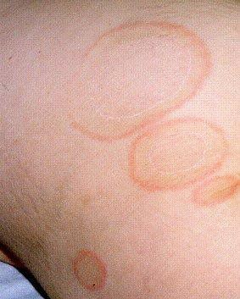
Erythema marginatum
Erythematous serpiginous macular lesions with pale centers.
Not pruritic.
Accentuated by skin warming.
https://www.hxbenefit.com/wp- content/uploads/2012/07/Eryth ema-marginatum-Picture.jpg Accessed 12/07/2019

Slide 122
Complications
Sydenham chorea
Characterized by involuntary and purposeless movements
Often associated with emotional lability
Symptoms become progressively worse and may be accompanied by ataxia and slurring of speech.
Muscular weakness becomes apparent following the onset of the involuntary movements.
Self-limiting
Presents months to years after infection

Slide 123
Complications
Up to 30% of cases
Females predominate
Emotional lability
Mild chorea is demonstrated by asking the patient to squeeze the examiner’s hands. Repetitive irregular squeezes are labeled as the milking sign

Slide 124
Rheumatic heart disease
Subendothelial damage limited to shallow depths as endothelium has great capacity to heal
If valvulitis is present, neo-angiogenesis develops within the substance of valve tissue, initiating a cycle of further inflammation and damage

Slide 125
Rheumatic heart disease
Gross pathology:
Nodular formations on mitral valve overlie areas of fibrinoid necrosis
Leaflet thickening
Commisural thickening and fusion
Thickening and fusion of chorda tendinae
“Fish mouth” appearance to valve
Subenodcardial immune complex deposition
MacCallum plaques are irregular thickenings in subendocardium

Slide 126
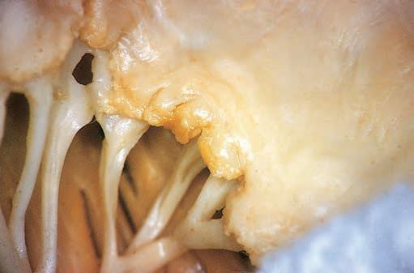
Rheumatic heart disease mitral valve
Schoen, and FJ, Mitchell, RN, “Heart”, in Kumar, V, Abbas, AK, Aster, JC (eds.), Robbins and Cotran Pathologic Basis of Disease, 9th edition. 2015. Elsevier.
Philadelphia. Fig. 12-23A. Accessed 09/04/2019

Slide 127
Rheumatic heart disease
Histopathology:
Immune complex deposition
Aschoff bodies in myocardium are pathognomonic of rheumatic fever
Nodules of mononuclear cells with central fibrinoid necrosis
Presence of Anitschkow cells
modified macrophages with nuclei that have central caterpillar-shaped chromatin
In rheumatoid arthritis myocarditis, rheumatoid nodules are noted in myocardium
•
•

Slide 128
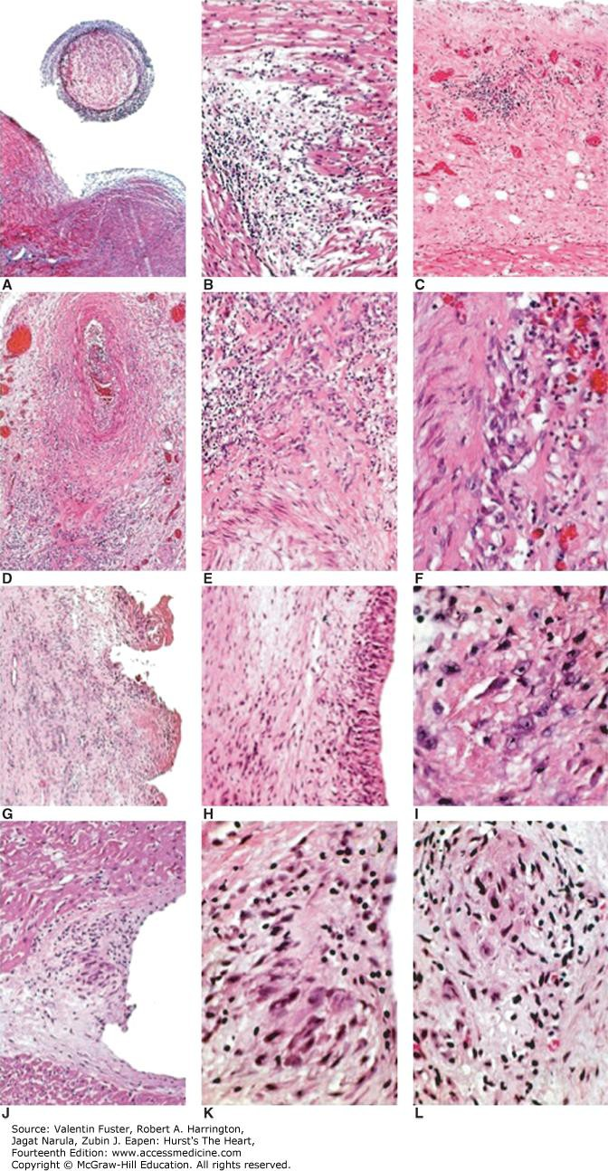
Hematoxylin and eosin staining of the heart and vasculature suggests connective tissue involvement in rheumatic fever. Modified with permission from Narula J, Virmani, R, Reddy KS, et al: Amer. Reg. Path. AFIP, Washington DC, 1999.
Citation: ACUTE RHEUMATIC FEVER, Fuster V, Harrington RA, Narula J, Eapen ZJ. Hurst's The Heart, 14e; 2017. Available at: https://accessmedicine.mhmedical.com/content.aspx?bookid=2046&sectionid=176557361 Accessed: April 22, 2020
Copyright © 2020 McGraw-Hill Education. All rights reserved

Slide 129
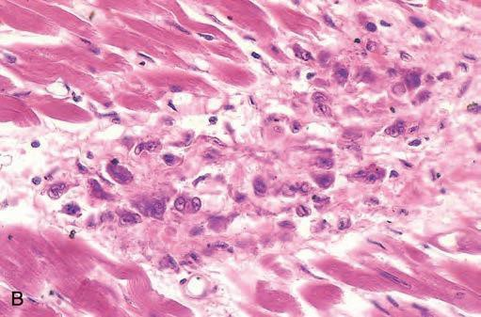
Aschoff body
Schoen, and FJ, Mitchell, RN, “Heart”, in Kumar, V, Abbas, AK, Aster, JC (eds.), Robbins and Cotran Pathologic Basis of Disease, 9th edition. 2015. Elsevier. Philadelphia. Fig. 12-23B. Accessed 09/02/2019

Slide 130
Treatment
Long acting benzathine penicillin
With no or transient cardiac involvement, 5–10 years of therapy or discontinuance in early adulthood
In severe disease, lifelong prophylaxis
ASA tailored to patient symptoms
No need for high doses
Corticosteroids if murmur present with carditis
Remain vulnerable to later Strep. Infections

Slide 131
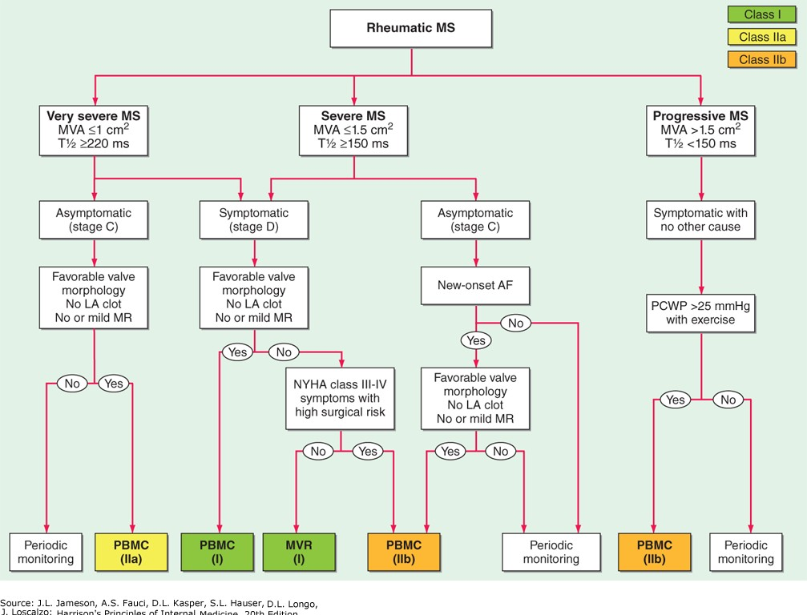

Slide 132
Calcification of the annulus
Degenerative
Women older than 60 years of age
As well as those with Mitral valve prolapse
Base of the leaflets
Clinically significant if interferes with physiologic opening/closing of mitral valve.
Calcified nodules may impinge upon AV conduction system
Nodules also site of thrombus formation
•

Slide 133
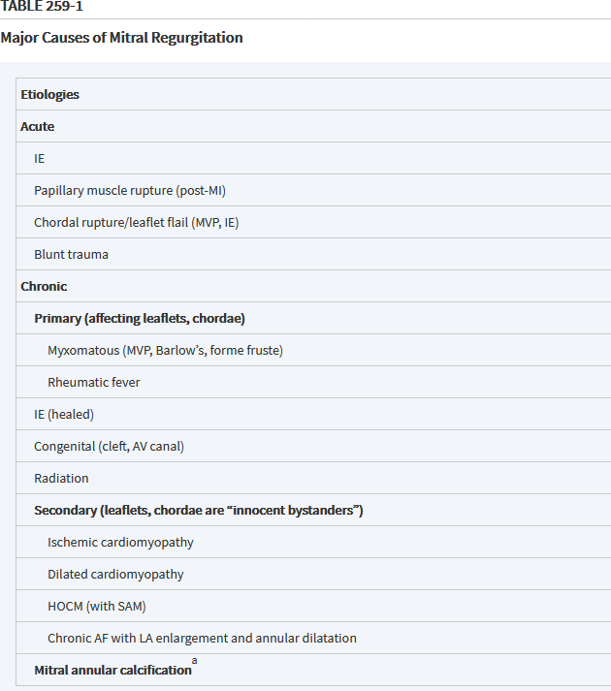

Slide 134
Mitral regurgitation
Post inflammatory rheumatic heart disease was the principal cause in the pre-antibiotic era.
Mitral valve prolapse is the principal cause today.
Infective endocarditis
Libmann-Sacks endocarditis in systemic lupus erythematosus

Slide 135
Mitral regurgitation
Chronic disease is frequently secondary to ischemia
May occur with fibrosis of a papillary muscle, in patients with healed myocardial infarction and ischemic cardiomyopathy.
May occur as a consequence of ventricular remodeling with papillary muscle displacement and leaflet tethering
Annular dilation and ventricular remodeling as mechanism in those with non-ischemic forms of dilated cardiomyopathy

Slide 136
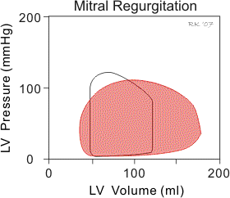
Mitral regurgitation (red)
https://www.cvphysiology.com/Heart%20Disease/HD009c

Slide 137
Mitral regurgitation
Severe disease presents with fatigue and dyspnea
High pitched blowing holosystolic murmur at the 5th or 6th left intercostal space at the mid-left thorax radiating to the apex and radiating into the left anterior axillary line or left axilla.
Diastolic rumble
Abrupt standing from a squatting position decreases the intensity of the murmurs
Squatting from a standing position increases the intensity of the murmurs.
Valsalva maneuver also increases the intensity of the murmur.

Slide 138
Mitral regurgitation
>40% regurgitant fraction in severe disease
Murmur intensity of Grade III (LR+ 3.5)
Grade IV (LR+ 14).
The absence of a murmur cannot exclude mitral insufficiency in a patient with acute myocardial infarction.
Doppler echocardiography is diagnostic
Palpitations may signal the onset of atrial fibrillation

Slide 139
Mitral regurgitation
As the left ventricle contracts, blood is not only ejected into the aorta but also back up into the left atrium.
This causes left atrial volume and pressure to increase during ventricular systole.
There is no true isovolumetric contraction phase because blood begins to flow across the mitral valve and back into the atrium before the aortic valve opens as soon as ventricular pressure exceeds left atrial pressure.

Slide 140
Mitral regurgitation
The afterload on the ventricle is reduced (total outflow resistance is reduced) so that end- systolic volume can be smaller than normal;
End-systolic volume can increase if the heart also goes into systolic failure.
There is no true isovolumetric relaxation phase because when the aortic valve closes and the ventricle begins to relax, the mitral valve is not completely closed so blood continues to flow back into the left atrium as long as intraventricular pressure is greater than left atrial pressure
Further decreasing ventricular volume

Slide 141
Mitral regurgitation
During ventricular diastolic filling, the elevated pressure within the left atrium is transmitted to the left ventricle during filling so that left ventricular end- diastolic volume (and pressure) increases.
Ventricular end-diastolic volume is also increased because in chronic mitral regurgitation the ventricle anatomically dilates (remodels) so that ventricular compliance is elevated
Because forward flow into the aorta is reduced, the net stroke volume falls.
Eventually increased end diastolic volume leads to increased afterload.

Slide 142
Mitral regurgitation
Left ventricle volume increases progressively with time as the severity of the regurgitation increases and as contractile function deteriorates.
Forward cardiac output falls.
Left ventricle end diastolic pressure does not rise until late.
Anticoagulation with either warfarin or a direct oral heparin agent should be provided if AF intervenes
Do not use in rheumatic heart disease or with a mechanical valve
Avoid isometric exercise

Slide 143
Mitral regurgitation
Fatigue and dyspnea as cardiac output falls and pulmonary pressures rise
LV compliance is often increased
LV diastolic pressure does not increase until late in the course.
The regurgitant volume varies directly with the LV systolic pressure and the area of the valve opening

Slide 144
Mitral regurgitation
Infarction
10-20% of cases in developed countries
The anterolateral papillary muscle has a dual blood supply from the left anterior descending and left circumflex arteries.
The posteromedial muscle has a singular blood supply from the right or dominant left circumflex coronary artery.
Thus, ischemic mitral valve regurgitation is more common following inferior-posterior rather than an anterior myocardial infarction
•

Slide 145
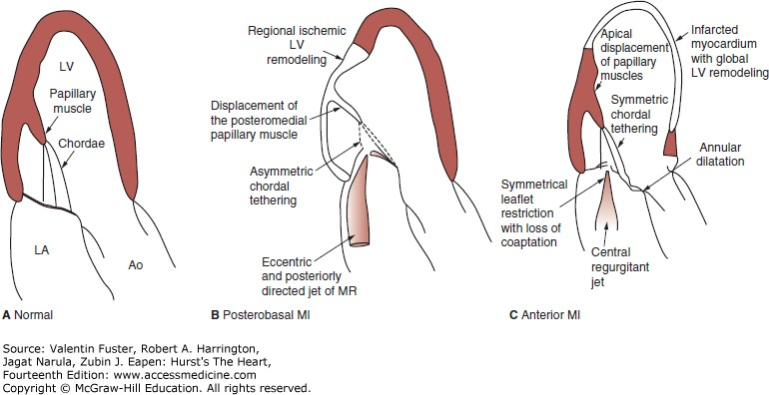
Mechanisms of ischemic mitral regurgitation (MR). Panel A demonstrates normal mitral valve and left ventricle (LV) anatomy. Panel B demonstrates mechanisms of ischemic MR following postero-basal myocardial infarction (MI) where regional LV remodeling results in displacement of the posteromedial papillary muscle with asymmetric tethering of the posterior mitral leaflet and eccentric MR. Panel C illustrates mechanism of MR following an anterior MI where global LV remodeling causes apical and lateral displacement of both papillary muscles; subsequent symmetric tethering of both mitral leaflets and annular dilatation generate central MR. Ao, Aortic root; LA, left atrium.
Citation: ISCHEMIC MITRAL REGURGITATION, Fuster V, Harrington RA, Narula J, Eapen ZJ. Hurst's The Heart, 14e; 2017. Available at: https://accessmedicine.mhmedical.com/content.aspx?bookid=2046&sectionid=176557719 Accessed: April 22, 2020
Copyright © 2020 McGraw-Hill Education. All rights reserved

Slide 146
Mitral regurgitation
Diuretics and intravenous vasodilators in the event of papillary muscle rupture
Immediate valve replacement
Surgical intervention with mitral valve repair if:
Recent onset of atrial fibrillation
Pulmonary hypertension
Progressive LV dysfunction
With ischemic disease, annuloplasty with an undersized, rigid ring, or chord sparing valve replacement with simultaneous coronary artery revascularization

Slide 147
Degenerative mitral valve disease
A spectrum of lesions
Simple chordal rupture involving prolapse of an isolated segment in an otherwise normal valve
P2 or the middle scallop of the posterior leaflet
Multi-segment prolapse involving one or both leaflets in a valve with significant excess tissue and a large annular size
Two main entities:
Fibroelastic deficiency
Barlow disease

Slide 148
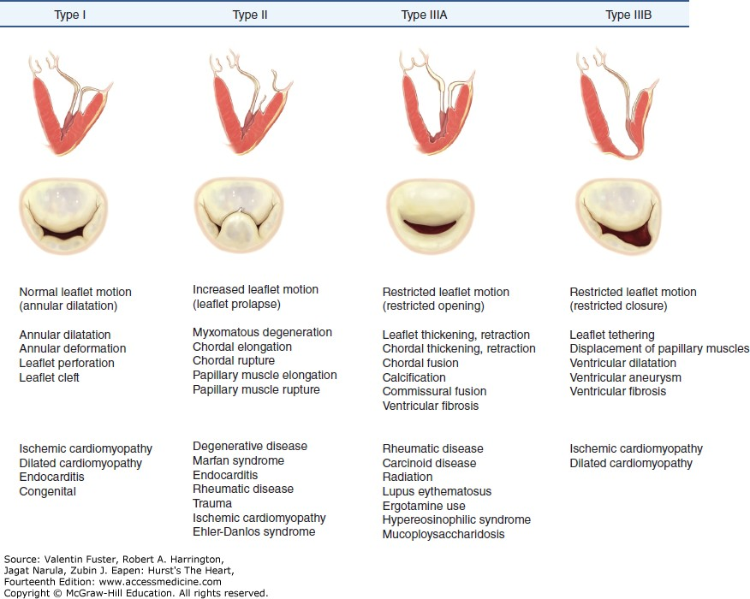
Pathophysiologic triad of mitral valve regurgitation composed of (top to bottom of each column): ventricular view, atrial view, leaflet dysfunction, valve lesions, and etiology.
Citation: DEGENERATIVE MITRAL VALVE DISEASE, Fuster V, Harrington RA, Narula J, Eapen ZJ. Hurst's The Heart, 14e; 2017. Available at: https://accessmedicine.mhmedical.com/content.aspx?bookid=2046&sectionid=176557605 Accessed: April 22, 2020
Copyright © 2020 McGraw-Hill Education. All rights reserved

Slide 149
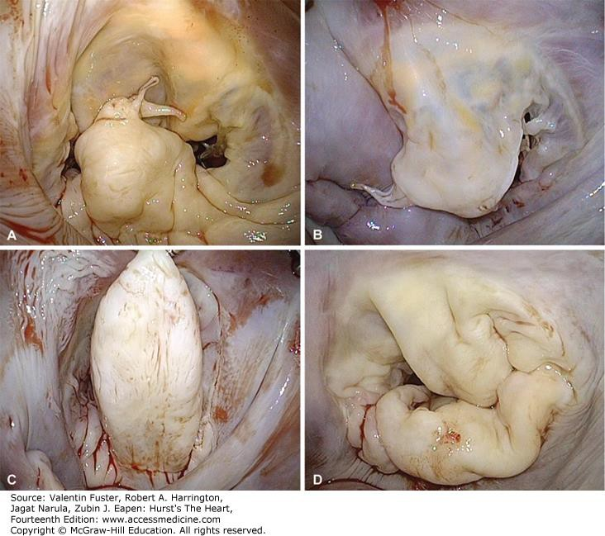
Valve lesions in degenerative mitral valve disease. A. Fibroelastic deficiency; isolated P2 prolapse secondary to chordal rupture and mild segmental thickening. B. Fibroelastic deficiency; anterior leaflet prolapse as a result of multiple ruptured chordae. C. Barlow disease; very tall and thickened P2 segment with otherwise normal P1 and P3 segments. D. Barlow disease; large valve with redundant, thick, bulky leaflets. Note the blurring of the junction between atrium and leaflet with fissures.
Citation: DEGENERATIVE MITRAL VALVE DISEASE, Fuster V, Harrington RA, Narula J, Eapen ZJ. Hurst's The Heart, 14e; 2017. Available at: https://accessmedicine.mhmedical.com/content.aspx?bookid=2046&sectionid=176557605 Accessed: April 22, 2020
Copyright © 2020 McGraw-Hill Education. All rights reserved

Slide 150
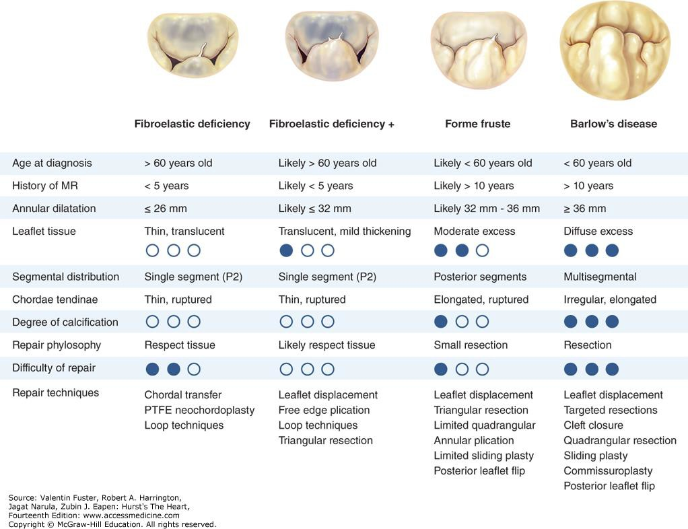
Characteristic clinical and surgical differences between fibroelastic deficiency and Barlow disease. MR, mitral regurgitation; PTFE, polytetrafluoroethylene.
Citation: DEGENERATIVE MITRAL VALVE DISEASE, Fuster V, Harrington RA, Narula J, Eapen ZJ. Hurst's The Heart, 14e; 2017. Available at: https://accessmedicine.mhmedical.com/content.aspx?bookid=2046&sectionid=176557605 Accessed: April 22, 2020
Copyright © 2020 McGraw-Hill Education. All rights reserved

Slide 151
Fibroelastic deficiency
1-3% of population
Presents in patients older than 60
Presents as mitral valve prolapse
Chordal rupture permits the middle scallop of the posterior valve leaflet to prolapse into the left atrium
Usually murmur is holosystolic and severe
May be autosomal dominant.
Fibrillin-1 mutation
Associated with Marfan’s syndrome
Associated with Ehler-Danlos syndrome

Slide 152
Barlow’s disease
Mitral valve prolapse as part of disease spectrum
Excess leaflet tissue
Leaflet thickening and distention
Diffuse chordal elongation, thickening, and/or rupture.
Severe annular dilatation with giant valve size
Additionally, varying degrees of annular calcification are often observed
Presents in younger women

Slide 153
Barlow’s disease
Myxomatous degeneration of valve (dermatan sulfate)
Fibrosis of valve a later development
May be secondary to ischemic dysfunction
Thrombotic plaques may be found at the
site of atrial-valve contact (Lambl excrescences)
A mid-systolic non-ejection sound (click) occurs in mitral valve prolapse and is followed by a late systolic murmur that crescendos to S₂.

Slide 154
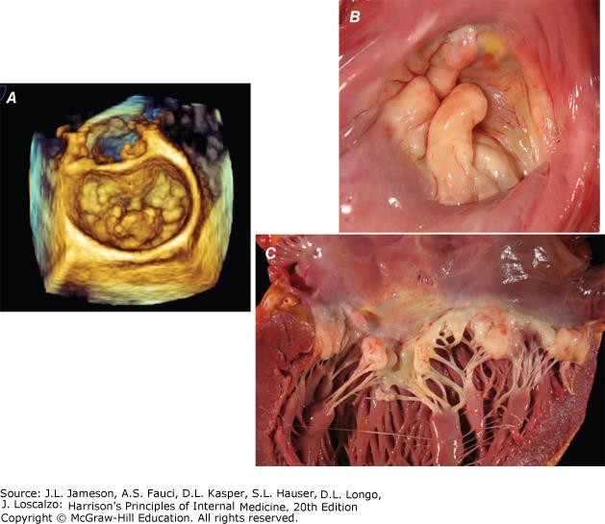
TTE
Citation: Chapter 260 Mitral Valve Prolapse, Jameson J, Fauci AS, Kasper DL, Hauser SL, Longo DL, Loscalzo J. Harrison's Principles of Internal Medicine, 20e; 2018. Available at: http://accessmedicine.mhmedical.com/content.aspx?bookid=2129&sectionid=192029561 Accessed: August 26, 2020
Copyright © 2020 McGraw-Hill Education. All rights reserved

Slide 155
Mitral valve prolapse
Standing decreases venous return
Heart becomes smaller
Mid-systolic click moves closer to S₁
Murmur of mitral regurgitation has an earlier onset.
With prompt squatting, venous return increases
Heart becomes larger
Mid-systolic click moves toward S₂
Duration of the murmur shortens.
Valsalva maneuver also decreases the intensity of the murmur.

Slide 156
Mitral valve prolapse
Presence of a non-ejection click (LR+ 3.8).
Presence of a systolic murmur with the click
Associated with long-term complications
Absence of a murmur and click rules out mitral valve prolapse (LR- 0.04)

Slide 157
Mitral valve prolapse
Myxomatous degeneration of the valve predisposes to severe regurgitation and chordal rupture, and is a frequent indication for mitral valve repair or replacement.
3% develop serious complications
Endocarditis prophylaxis.
ASA if a history of embolic disease.
β-blocker only if symptomatic with non-anginal chest pain, anxiety, or arrhythmia
Significant mitral valve regurgitation may develop

Slide 158
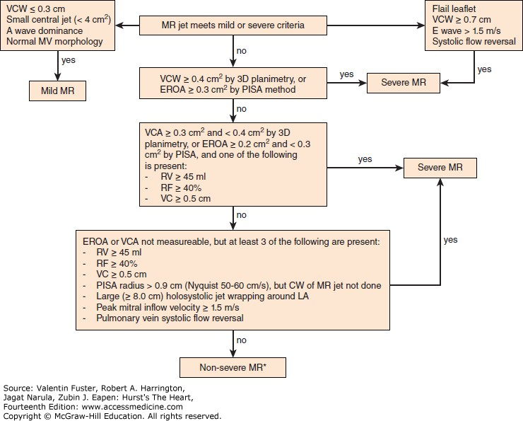
Citation: DEGENERATIVE MITRAL VALVE DISEASE, Fuster V, Harrington RA, Narula J, Eapen ZJ. Hurst's The Heart, 14e; 2017. Available at: https://accessmedicine.mhmedical.com/content.aspx?bookid=2046&sectionid=176557605 Accessed: April 22, 2020
Copyright © 2020 McGraw-Hill Education. All rights reserved

Slide 159
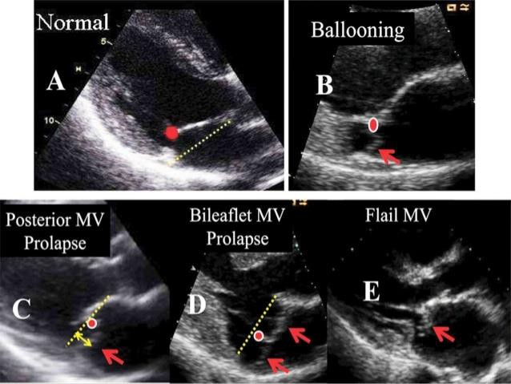
http://image.slidesharecdn.com/mrecho-150211075734-conversion-gate01/95/echocardiographic-evaluation-of- mitral-valve-disease-mitral-regurgitation-19-638.jpg?cb=1423663330 Accessed 12/07/2019

Slide 160
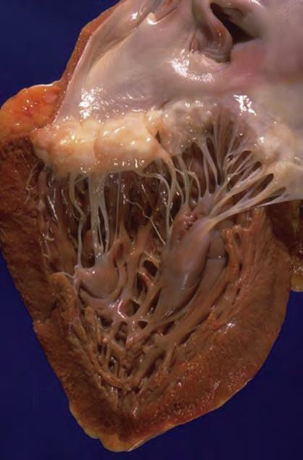
Myxomatous mitral valve (prolapse)
Klatt, EC, Robbins and Cotran Color Atlas of Pathology. (2015) Elsevier. Philadelphia. Fig. 2-46

Slide 161
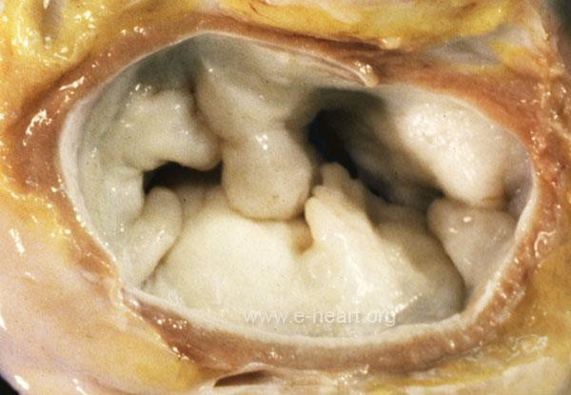
Marfan’s syndrome

Slide 162
Mitral valve prolapse
Prunotto, M, Caimmi, PP, Bongiovanni, M, “Cellular pathology of mitral valve prolapse,” Cardiovascular Pathology (2010) 19: e113-117 https://doi.org/10.1016/j.carpath.2009.03.002 Accessed 12/10/2019

Slide 164
Pressure-volume relationship
Aortic stenosis is characterized by increased after- load.
Both systolic and diastolic pressures rise.
Pulse pressure widens.
Mitral stenosis is characterized by decreased pre- load.
Pulse pressure unchanged.

Slide 165
Pressure-volume relationship
Aortic insufficiency is characterized by increased preload.
Systolic pressure rises while diastolic pressure lags
Wide pulse pressure
Mitral insufficiency is characterized by decreased afterload.
Systolic pressure falls
Pulse pressure narrows.

Slide 166
Atrial myxoma
30-50% of primary tumors of the adult heart
Middle aged women
90% arise in the atria
4:1 preponderance on left.
Arises near fossa ovalis.
Space occupying lesion in atrium
May function as ball-valve if pedunculated
Composed of stellate cells embedded in an acid mucopolysaccharide ground substance.
Abortive gland or vessel formation noted.
Mesenchymal origin

Slide 167
Atrial myxoma
Familial form (Carney complex)
7% of atrial myxomas
Young age
Multicentric
Pigmented nevi
Fibromyxomatous skin tumors
Pigmented nodular adrenocortical tumors
Autosomal dominant
70%, PRKAR1A null mutation (cAMP)
McCune-Albright syndrome (GNAS1 mutation) is not associated with atrial myxoma

Slide 168
Atrial myxoma
Lateral chest x-ray of a 16- year-old girl with syncope. Two areas of dense calcification (arrowheads) overly the posterior aspect of heart. At surgery a calcified myxoma of the right atrium was removed.
Fig. 2-2
Burke, A, and, Virman, R, “Tumors of the heart and great vessels.” Atlas of Tumor Pathology. Third Series. Fascicle 16. Armed Forces Institute of Pathology.
Washington, D.C. 1996.

Slide 169
Atrial myxoma
A gelatinous tumor is attached by a narrow
pedicle to the atrial septum. The myxoma has an irregular surface and nearly fills the left atrium.
Fig. 3-1
Burke , A, and, Virman, R, “Tumors of the heart and great vessels.” Atlas of Tumor Pathology. Third Series. Fascicle
16. Armed Forces Institute of Pathology. Washington, D.C. 1996.

Slide 170
Atrial myxoma
Scattered stellate cells in a myxoid stroma.
https://webpath.med.utah.edu/CVHTML/CV076.html
Accessed 12/10/2019

Slide 171
Rhabdomyoma
Most common pediatric tumor of heart
>50% associated with Tuberous sclerosis
Multiple in 90% of cases
Often asymptomatic
Predilection for left ventricle and may present with outflow obstruction
Hamartoma of embryonal myocytes
Gross Pathology
Yellow-tan solid, circumscribed, unencapsulated lesions
Histopathology
Characteristic spider cell
large clear cell with glycogen cytoplasmic strands extending to the plasma membrane.

Slide 172
Rhabdomyoma
Firm, white tumor mass fills the ventricle
https://webpath.med.utah.edu/CVHTML/CV076.html
Accessed 12/10/2019

Slide 173
Other cardiac tumors
Benign:
Fibroma
Lipoma
Paraganglioma
Histiocytoid tumor
Sarcoma is the primary malignant tumor
25% of cardiac tumors
Metastatic disease usually from breast or lung primary
50-65% of melanomas will metastasize to heart

Slide 174
Harrison's Principles of Internal Medicine, 20e > Pulmonic Valve Disease

Slide 175
Pulmonic valve stenosis
Pulmonic valve stenosis with intact ventricular septum
Congenital
Noonan syndrome
50% have PTPN1 gene mutation at 12
RV dysfunction from afterload mismatch occurs earlier in the course of PS and at lower peak systolic pressures
Usually asymptomatic

Slide 176
Pulmonic valve stenosis
Ejection click and early systolic murmur
Ejection click more prominent on expiration
Pulmonic component of S₂ delayed
Right ventricular systolic ejection becomes progressively longer
Increased obstruction to flow.
As the pulmonic gradient increases
isometric contraction shortens

Slide 177
Pulmonic valve stenosis
In severe pulmonic stenosis with concentric hypertrophy
Decreasing right ventricular compliance
S₄ appears
Critical pulmonic valve stenosis
Newborns
Present with right heart failure.
Right sided valvular lesion
Increased murmur intensity on inspiration

Slide 178
Treatment
Diuretics can be used to treat symptoms and signs of right heart failure.
Provided there is less than moderate pulmonic regurgitation (PR), percutaneous pulmonic balloon valvotomy is recommended for symptomatic patients with a domed valve.
Dysplastic valve requires replacement.

Slide 179
Pulmonic valve regurgitation
Pulmonic valve regurgitation
Usually functional (stretching of ring)
Pulmonary hypertension
Carcinoid syndrome
Asymptomatic if mild
PR is a state of increased preload and afterload
RV chamber enlargement and eccentric hypertrophy
Loud S₂ followed by a decrescendo diastolic murmur (Graham-Steel murmur)
Echocardiography diagnostic

Slide 180
Treatment
In patients with functional PR due to PA hypertension and annular dilation, efforts to reduce PA vascular resistance and pressure should be optimized.
Diuretics can be used to treat the manifestations of right heart failure
Idiopathic PA hypertension, left-sided heart valve disease etiologies managed with vasodilators and surgical intervention
Surgical valve replacement rarely undertaken
Transcatheter pulmonic valve replacement if congenital heart disease

Slide 181
Carcinoid syndrome
Systemic disorder
Presents with
Flushing
Diarrhea
Bronchoconstriction
Dermatitis
Right heart lesions predominate
Pulmonary vascular bed degrades biogenic amines
Serotonin levels correlate with cardiac lesion severity
5-HIAA metabolite elevated in urine

Slide 182
Carcinoid syndrome
Gross pathology:
White intimal plaque-like thickening of endocardial surfaces
Histopathology:
Principally smooth muscle cells embedded in an acid mucopolysaccharide matrix
Causes:
Agents affecting serotonin metabolism
Fenfluramine
Ergotamine and methysergide are metabolized to serotonin in the pulmonary vasculature

Slide 183
Carcinoid syndrome
Causes:
Carcinoid tumors
Bioactive compounds produced by intestinal carcinoids travel via portal vein to liver
Generally inactivated
Large metastatic burden in liver associated with syndrome as quantity of bioactive compounds produced exceeds hepatic capacity to metabolize them
Primary pulmonary carcinoids will act directly on the left side of the heart
•
•
•

Slide 184
Carcinoid syndrome
Bioactive compounds of rectal carcinoids travel via the inferior vena cava and bypass the liver
Produce right heart lesions
Tricuspid insufficiency predominates
Bioactive compounds of pulmonary carcinoids act directly on the left side of the heart
Aortic and mitral regurgitation
•

Slide 185
Harrison's Principles of Internal Medicine, 20e > Pulmonic Valve Disease

Slide 186
Tricuspid stenosis
Tricuspid stenosis with regurgitation
Rheumatic heart disease is the most common cause of this lesion.
Usually associated with mitral stenosis
Carcinoid syndrome
Staph. aureus infective endocarditis associated with intravenous drug use
Right ventricle catheter leads
Anticardiolipin antibody
Rheumatoid arthritis
Systemic lupus erythematosus

Slide 187
Tricuspid stenosis
Because the development of MS generally precedes that of TS, many patients initially have symptoms of pulmonary congestion and fatigue.
Relatively little dyspnea for the degree of hepatomegaly, ascites, and edema associated with TS
The jugular veins are distended
May be giant a waves.
The v waves are less conspicuous
There is a slow y descent.
Systolic murmur along lower left sternal border that increases with inspiration

Slide 188
Tricuspid stenosis
Opening snap follows P₂
Diastolic murmur along lower left sternal border and over the xiphoid
Occurs immediately pre-systole
Increases with respiration
The absence of EKG evidence of RV hypertrophy (RVH) in a patient with right-sided heart failure who is believed to have MS should suggest associated tricuspid valve disease.
Prominent RA and SVC on chest x-ray
Trans-thoracic echocardiography (TTE) diagnostic

Slide 189
Treatment
Salt restriction, bed rest, diuretic therapy in pre- operative period to reduce hepatic congestion
Surgical repair at time of mitral valve surgery
If repair not possible, valve replacement
Mechanical valves more prone to thromboembolic complications than at any other site

Slide 190
Tricuspid valve regurgitation
80% functional (stretching of ring)
Usually asymptomatic
Adults
Also associated with aortic and mitral regurgitation
Also associated with Ebstein anomaly
Blowing holosystolic murmur at the lower left sternal margin.
Increased on inspiration

Slide 191
Tricuspid valve regurgitation
RA enlargement and elevation of the RA and jugular venous pressures with prominent c-v waves and rapid y descent
Pulsatile jugular venous distention
Pulsatile liver
Trans-thoracic echocardiography (TTE) diagnostic

Slide 192
Treatment
Diuretics can be useful for patients with severe TR and signs of right heart failure
An aldosterone antagonist may be employed because many patients have secondary hyperaldosteronism from marked hepatic congestion
If secondary to left heart disease, therapy to reduce PA pressure or pulmonary vascular resistance as well as LV pressure
Surgical repair in severe disease

Slide 193
Strategy
Fig. 230-1 Accessed 03/26/2010

Slide 194
Strategy
Fig. 230-4 Accessed
03/21/2010

Slide 195
Strategy
Fig. 230-5 Accessed 03/25/2010

Slide 196
Strategy
Fig. 230-6 Accessed 03/25/2010

Slide 197
Prosthetic valves
Bioprosthetic valves
Xenograft valves favored in those over 65 years of age
Porcine or bovine
Human donor grafts are also available.
10-20 year valve life
10% of bioprosthetic aortic valves require anticoagulation over valve life
60% of bioprosthetic mitral valves require anticoagulation over valve life
Stenosis or calcification as reasons for failure

Slide 198
Mechanical prosthetic valves
Caged valves and tilting disc valves
Cavitation mechanics
20-30 year lifetime
Audible click may be disturbing to patient
The St. Jude Floating bi-leaflet metallic valve
Pivots about a central axis
Central blood flow
Biocompatible
Fewer complications than other mechanical valves
Favored in those less than 65 years of age.
Lifelong anticoagulation

Slide 199
Prosthetic valves
Thrombus formation and infection are the two common reasons for prosthetic valve failure
University of Chicago Surgical Pathology Manual

Slide 200
Infective endocarditis
©Kenneth Alonso, MD, FACP

Slide 201
Infective endocarditis
5-15 cases per 100,000 population per year.
Fourth most common life-threatening infection (after sepsis, pneumonia, intra-abdominal abscess).
Classification is based on clinical course.
Clinical signs are due to circulating micro- organisms.

Slide 202
Infective endocarditis
Acute infective endocarditis is rapidly progressive, fulminant disease (days) associated with valve destruction.
Both native and diseased valves at risk.
Subacute infective endocarditis is a less fulminant process (2-3 weeks) associated with valve destruction.
Diseased valves are at risk.

Slide 203
Predisposing conditions
Transient Bacteremia
Intravenous Drug Use
Indwelling venous catheters
Dental, surgical, and endoscopic procedures
Genitourinary manipulation and abortion
Ulcerative colitis, adenocarcinoma of the colon

Slide 204
Predisposing conditions
Underlying valvular disease:
Rheumatic heart disease (principally, mitral valve)
Mitral Valve Prolapse
Bicuspid Aortic Valve
Intracardiac shunts (jet streams)
Prosthetic Valve

Slide 205
Infective endocarditis
Fever is the common manifestation.
Fevers >38.4C are associated with a fulminant course.
Chills (rigors) may be present when embolic seeding occurs from the diseased valve.
There is no fixed cycle.
Often anorexia is described.
A regurgitant heart murmur is characteristic of valve destruction.
It may be present in up to 90% of patients.

Slide 206
Infective endocarditis
The Oslerian triad of sustained bacteremia, acute valvulitis, peripheral emboli, and immune complex phenomena is not often seen today.
Pleuritic pain followed by hemoptysis may be seen in acute endocardits.
Dyspnea or even signs of congestive heart failure may develop.
Heart failure noted in 32% of patients
Aortic>Mitral>>Tricuspid in incidence

Slide 207
Infective endocarditis
Immune complexes may deposited in lungs, synovium, and glomeruli.
Glomerulonephritis with nephritic syndrome may be seen in 60% of patients. Proteinuria, hematuria, red cell casts may be demonstrated in the urine. Rarely does it lead to renal failure.
Splenomegaly may also be found in 30% of patients and represents long-standing disease.
Neurologic lesions due to emboli in 15-30% of patients.
Non-embolic stroke also noted in 17%.

Slide 208
Septic emboli
Janeway lesions (painless hemorrhagic macules on palms or soles) are found in 40-50% of patients but may be transient;
Subconjunctival hemorrhages are found in 20% of patients.
Roth spots (hemorrhages with pale centers in retinal fundus) are found in <5% of patients;
Splinter hemorrhages in nail beds are found in 10% of patients;
Osler nodes (painful, on pads of fingers and toes) are found in 5% of patients.

Slide 209
Mycotic aneurysms
Mycotic aneurysms are microabscesses in arterial walls.
Cerebral involvement involves the anterior circulation.
The aneurysms are peripherally located and fusiform in appearance.
Up to one-third occur before the Circle of Willis.
CT mutlidetector angiography diagnostic.
Endovascular or surgical treatment advised if patient otherwise good surgical risk.
Weak association between size and rupture.

Slide 210
Mycotic aneurysms
Frequency in descending order
Related to entry site
Aorta
Peripheral arteries (femoral)
Cerebral arteries
Mortality rate 60%; if rupture, 80%
Visceral arteries (superior mesenteric)

Slide 211
Septic embolus
(Courtesy of Lindsey Baden, MD; with permission.)

Slide 212
Septic embolus
Osler node
Janeway lesion
UCSD Catalog of Digital Images. Accessed 09/10/2019

Slide 213
Septic embolus
Splinter hemorrhage
Dermnet NZ Accessed 09/10/2019

Slide 214
Septic embolus
Roth Spot
Cooke, RA, and Stewart,B, Colour Atlas of Pathology, 3rd edition. (2004) Curchill Livingstone. Edinburgh. Fig. 1-59.

Slide 215
Septic embolism
Mycotic
aneurysm
Lee, Wai-Kit, Mossop, Peter J., Little, Andrew F., Fitt, Gregory J, Vrazas, Jhon I., Hoang, Jenny K., Hennessy, Oliver F., Infected (Mycotic) Aneurysms: Spectrum of Imaging Appearances and Management.
Radiographics (2008)
28(7): 1853-1868.
doi.org/10.1148/rg.2870850 54
Figure 6b.

Slide 216
Pathogenesis
Vegetations on heart valves are characteristic.
The organisms that commonly cause endocarditis have surface adhesion molecules that adhere to matrix of injured endothelium.
Fibronectin binding proteins (present on many gram positive organisms) facilitate adherence.
Platelet adhesion and a local procoagulant response is induced. Inflammation follows.

Slide 217
Pathogenesis
Valvular murmurs at site of disease as vegetations destroy valve (and chordae tendinae) and lead to valve dysfunction.
As mitral valve structural abnormalities are more common, the mitral valve is the valve generally affected.

Slide 218
Infective endocarditis
Vegetation Septic thrombus
Klatt, EC, Robbins and Cotran Color Atlas of Pathology. (2015) Elsevier. Philadelphia.
Fig. 2-60

Slide 219
Infective endocarditis
Native mitral valve.
Schoen, and FJ, Mitchell, RN, “Heart”, in Kumar, V, Abbas, AK, Aster, JC (eds.), Robbins and Cotran Pathologic Basis of Disease, 9th edition. 2015. Elsevier. Philadelphia. Fig. 12-25A.

Slide 220
Infective endocarditis
Native aortic valve
Klatt, EC, Robbins and Cotran Color Atlas of Pathology. (2015) Elsevier. Philadelphia.
Fig. 2-55

Slide 221
Infective endocarditis
is
Mitral valve
regurgitation
The Lancet

Slide 222
Infective endocarditis

Slide 223
Infective endocarditis
Prosthetic aortic valve

Slide 225
Blood culture positive
Typical microorganisms consistent with infective endocarditis
Viridians streptococci Streptococcus bovis HACEK group Staphylococcus aureus
Community-acquired enterococci in the absence of a primary focus
Single positive blood culture for Coxiella burnetii or anti–phase 1 IgG antibody titer ≥1:800
Single positive blood culture for slow growing pathogen
•

Slide 226
Blood culture
Blood cultures must be obtained from different sites
Optimal sampling time is if rigor is present as is associated with organism showering into blood
At least 2 positive blood cultures drawn >12 h apart
OR all 3 positive blood cultures drawn >12 h apart
OR a majority of ≥4 separate cultures of blood
with first and last sample drawn at least 1 h apart

Slide 227
Major imaging criteria
Evidence of subendocardial involvement
Transthoracic echocardiogram
Positive for infective endocarditis
OR rated at least possible infective endocarditis by clinical criteria
OR complicated infective endocarditis
[paravalvular abscess]

Slide 228
Paravalvular abscess
Oscillating Intracardiac mass on valve or supporting structures;
OR In the path of regurgitant jets;
OR on implanted material in the absence of an alternative anatomic explanation;
OR abscess;
OR new partial dehiscence of prosthetic valve or new valvular regurgitation
Trans esophageal echocardiogram preferred to transthoracic echocardiogram
•
•
•
•
•
•

Slide 229
Minor criteria
Predisposition, predisposing heart condition, or intravenous drug use
Fever, temperature >38°C
Vascular phenomena
Major arterial emboli
Septic pulmonary infarcts
Mycotic aneurysm
Intracranial hemorrhage
Conjunctival hemorrhages
Janeway lesions
Roth spots

Slide 230
Minor criteria
Immunological phenomena:
Glomerulonephritis
Osler nodes
Rheumatoid factor present
Microbiological evidence:
Positive blood culture but does not meet a major criterion as noted above
(excludes single positive cultures for coagulase negative staphylococci and organisms that do not cause endocarditis),
OR serological evidence of active infection with organism consistent with infective endocarditis

Slide 231
Caveat
Worsening or changing or pre-existing murmur is not a sufficient criterion for diagnosis

Slide 232
Microbiological clues
Staph. Aureus
Most commonly found micro-organism in endocarditis in the developed world (reflects health care contact).
Affects both normal and diseased valves.
Major cause of tricuspid valve destruction
Associated with intravenous drug use
Fulminant disease.

Slide 233
Microbiological clues
Coagulase negative Staph. (epidermidis)
Associated with prosthetic valve associated endocarditis.
Strep. Viridians
Second most commonly found micro-organism in endocarditis.
Affects diseased valves.
Aerobic Gram-negative bacilli (HACEK) include Hemophilus, Actinobacillus, Cardiobacterium, Eikenella, and Kingella.
Usually associated with poor dental heath.

Slide 234
Epidemiological Clues
Intravenous drug use
Staph. aureus, including community-acquired oxacillin-resistant strains
Coagulase-negative staphylococci
β-hemolytic streptococci
Fungi
Aerobic Gram-negative bacilli, including Pseudomonas aeruginosa
Polymicrobial

Slide 235
Prosthetic valve clues
Early (≤1 y) prosthetic valve placement
Coagulase-negative staphylococci
Staph. aureus
Aerobic Gram-negative bacilli
Fungi
Corynebacterium species
Legionella species

Slide 236
Prosthetic valve clues
Late (>1 y) prosthetic valve placement
Coagulase-negative staphylococci
Staph. aureus
Strep. viridians
Enterococcus species
Fungi
Corynebacterium species

Slide 237
Medical history clues
Indwelling cardiovascular medical devices
Staph. aureus
Coagulase-negative staphylococci
Fungi
Aerobic Gram-negative bacilli
Corynebacterium species
Poor dental health, dental procedures
Strep. viridians
Nutritionally variant streptococci (Abiotrophia defectiva, Granulicatella species, Gemella species)
HACEK organisms

Slide 238
Medical history clues
Genitourinary disorders, infection, and manipulation, including pregnancy, delivery, and abortion
Enterococcus species
Group B streptococci (Strep. agalactiae)
Listeria monocytogenes
Aerobic Gram-negative bacilli
Neisseria gonorrheae
Gastrointestinal lesions
Strep. gallolyticus (bovis)
Enterococcus species
Clostridium septicum

Slide 239
Medical history clues
Chronic skin disorders, including recurrent infections
Staph. aureus
β-hemolytic streptococci
Burn
Staph. aureus
Aerobic Gram-negative bacilli, including
P. aeruginosa
Fungi

Slide 240
Medical history clues
AIDS
Salmonella species
Strep. pneumoniae
Staph. Aureus
Pneumonia, meningitis
Strep. Pneumoniae
Solid organ transplantation
Staph. aureus
Aspergillus fumigatus
Enterococcus species
Candida species

Slide 241
Medical history clues
Diabetes mellitus
Staph. aureus
β-hemolytic streptococci
Strep. Pneumoniae
Alcoholism, cirrhosis
Bartonella species
Aeromonas species
Listeria species
Strep. pneumoniae
β-hemolytic streptococci

Slide 242
Medical history clues
Dog or cat exposure
Bartonella species
Pasteurella species
Capnocytophaga species
Contact with contaminated milk or infected farm animals
Brucella species
Coxiella burnetii
Erysipelothrix species
Body lice
Bartonella species

Slide 243
Treatment guides
Drug selection is initially guided by Gram-stain until definitive identification antibiotic sensitivities are available.
If an acute presentation (days), native valve, treat for Staph. aureus, β-hemolytic Strep., and aerobic Gram-negative bacilli until culture results available.
If a subacute presentation (weeks), native valve, treat for Staph. aureus, Strep. viridians, HACEK, and Enterococcus until culture results available.

Slide 244
Treatment guides
If prosthetic valve and <1yr has passed since placement, treat for Staph., Enterococcus, and aerobic Gram-negative bacilli until culture results available.
If prosthetic valve and >1yr has passed since placement, treat for Staph., Strep. Viridians, and Enterococcus until culture results available.

Slide 245
Gram positive cocci
In clusters. Staphylococcus.
Color plate 1 Accessed 07/01/2010
In chains. Streptococcus.
Color plate 2 Accessed 07/01/2010

Slide 246
Gram-negative bacilli
Arrow points to a
gram-negative rod.
Provider: Professor Shirley Lowe, University of California, San Francisco School of Medicine. With permission.
Color plate 8 Accessed 08/01/2010

Slide 247
Treatment
Native valve endocarditis (Strep. viridians or Strep. Bovis)
4 weeks therapy as minimum
Penicillin G or Ceftriaxone
If rapidly resolving and no renal disease is present, gentamicin may be added and the duration of therapy may be shortened to 2 weeks.
Vancomycin is substituted for those who cannot tolerate penicillin or ceftriaxone.

Slide 248
Treatment
Native valve endocarditis (Methicillin sensitive Staph. Aureus) is best treated with a β-lactam antibiotic.
Six weeks of therapy
Nafcillin is preferred to cefazolin if: Brain abscess present
Complicated right sided endocarditis.
Cefazolin is acceptable for those with non- anaphylactoid reactions to penicillin.
Neither rifampin nor clindamycin should be used as associated with higher levels of relapse.
•
•
•
•
•

Slide 249
Treatment
Methicillin resistant Staph. aureus left sided endocarditis
6 weeks therapy
Vancomycin with daptomycin
OR daptomycin
Surgical intervention is generally avoided in cases of intravenous drug use.

Slide 250
Treatment
In the presence of prosthetic valves or other prosthetic material
6 weeks of therapy vancomycin and rifampin
with gentamycin limited to the first two weeks Effective for coagulase negative Staph. as
well as Staph. Aureus.
•
•
•
•

Slide 251
Treatment
E. fecails is generally the enterococcus isolated.
Frequently it is resistant to aminoglycosides.
Ceftriaxone with ampicillin for six weeks is effective therapy.
Ceftriaxone therapy for 4 weeks is effective for treating HACEK organisms; 6 weeks, if prosthetic valve.

Slide 252
Treatment
Non-HACEK Gram-negative bacilli
6 weeks treatment
β-lactam antibiotic and an aminoglycoside
OR fluoroquinolone
Surgical removal of the valve is often required.

Slide 253
Indications for Surgical Intervention
Fifty percent of infected valves are replaced to both control the infection and restore function.
Vegetation
Persistent vegetation after systemic embolization
Anterior mitral leaflet vegetation, particularly with size >10 mm
≥1 Embolic events during first 2 wk of antimicrobial therapy
Increase in vegetation size despite appropriate antimicrobial therapy

Slide 254
Indications for surgical intervention
Valvular dysfunction
Acute aortic or mitral insufficiency with signs of ventricular failure
Heart failure unresponsive to medical therapy
Valve perforation or rupture
Perivalvular extension
Valvular dehiscence, rupture, or fistula
New heart block
Large abscess or extension of abscess despite appropriate antimicrobial therapy

Slide 255
Monitor therapy
Two sets of blood cultures are drawn every 24-48 hours until bloodstream infection clears.
If operative tissue cultures are positive, follow with an entire course of antibiotic therapy.
Anticoagulation is problematic.
Life-long endocarditis prophylaxis before any minor surgical procedure.
Life-long azole therapy if treated fungemia.

Slide 256
Non-thrombotic bacterial (marantic) endocarditis
Sterile verrucous vegetations (thrombus cap)
No inflammatory infiltrate in tissue
Frequently occurs concomitantly with deep venous thromboses or pulmonary emboli (hypercoagulable state)
Procoagulant effect of circulating mucin from mucinous adenocarcinomas. (Trousseau syndrome)
Similar lesions are seen in antiphospholipid syndrome.
Indwelling vascular catheters also associated with similar changes on heart valves
Rarely embolize.

Slide 257
Non-thrombotic bacterial (Marantic) endocarditis
Schoen, and FJ, Mitchell, RN, “Heart”, in Kumar, V, Abbas, AK, Aster, JC (eds.), Robbins and Cotran Pathologic Basis of Disease, 9th edition. 2015. Elsevier.
Philadelphia. Fig. 12-26B.

Slide 258
Non-thrombotic bacterial (Marantic) endocarditis
Schoen, and FJ, Mitchell, RN, “Heart”, in Kumar, V, Abbas, AK, Aster, JC (eds.), Robbins and Cotran Pathologic Basis of Disease, 9th edition. 2015. Elsevier. Philadelphia. Fig. 12-26A.

Slide 259
Liebman-Sacks endocarditis
Small, sterile vegetations
Fibrinoid necrosis along undersurface of mitral and tricuspid valves, chordae tendinae, valvular or mural endocardium
There is a valvulitis present.
Fc-receptor-bearing cells are recruited in the inflammatory response.
Do not embolize.
May lead to mitral regurgitation; however, are often not clinically important.
Occur in up to 25% of patients with Systemic Lupus Erythematosus (seropositive).

Slide 260
Liebman-Sacks endocarditis

Slide 261
Liebman-Sacks endocarditis
Klatt, EC, Robbins and Cotran Color Atlas of Pathology. (2015) Elsevier. Philadelphia. Fig. 2-64

Slide 262
Rheumatic heart disease
Rheumatic phase
Immune complexes circulating
Small, verrucous lesions may be found all along the mitral valve as well.
Sterile

Slide 263
Vegetation distribution
RHD
IE
NTBE
LSE
Schoen, and FJ, Mitchell, RN, “Heart”, in Kumar, V, Abbas, AK, Aster, JC (eds.), Robbins and Cotran Pathologic Basis of Disease, 9th edition. 2015. Elsevier. Philadelphia. Fig. 12-24.

